Slide 1
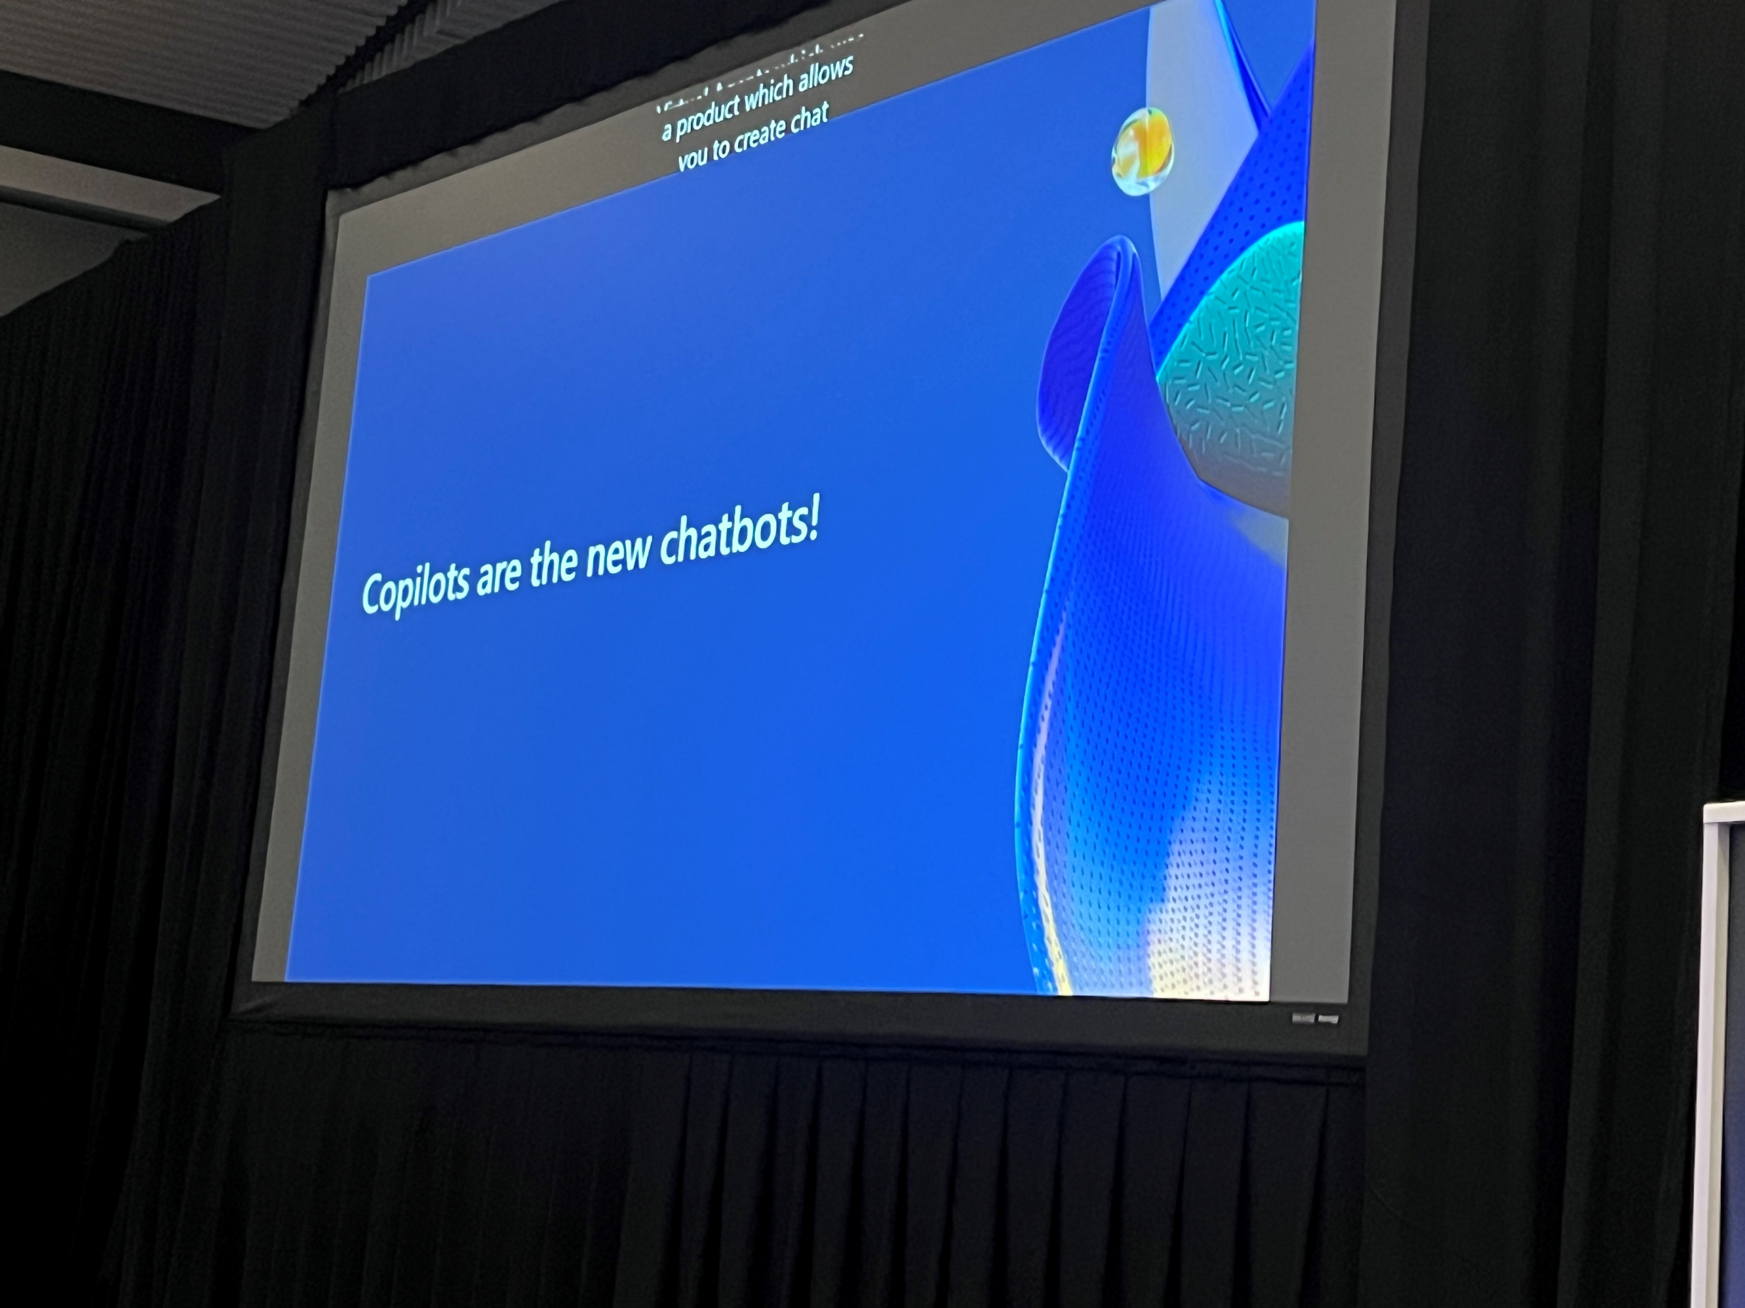
Building and extending Copilots to accelerate productivity

Slide 2
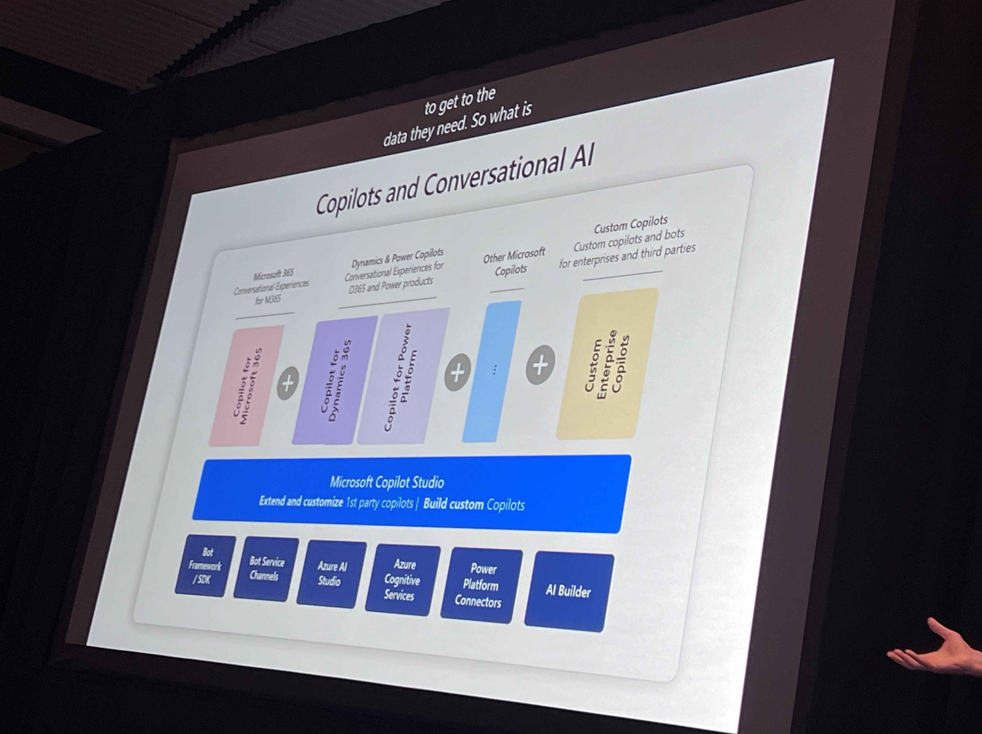
Building and extending Copilots to accelerate productivity

Slide 3
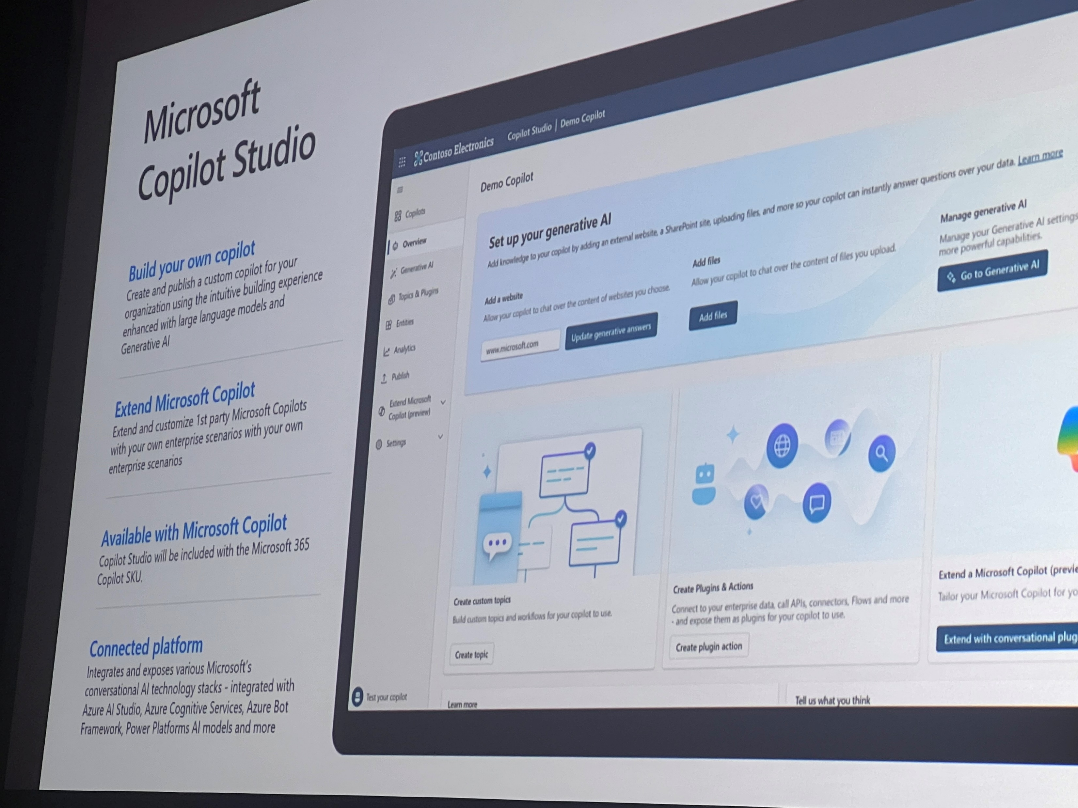
Building and extending Copilots to accelerate productivity

Slide 4
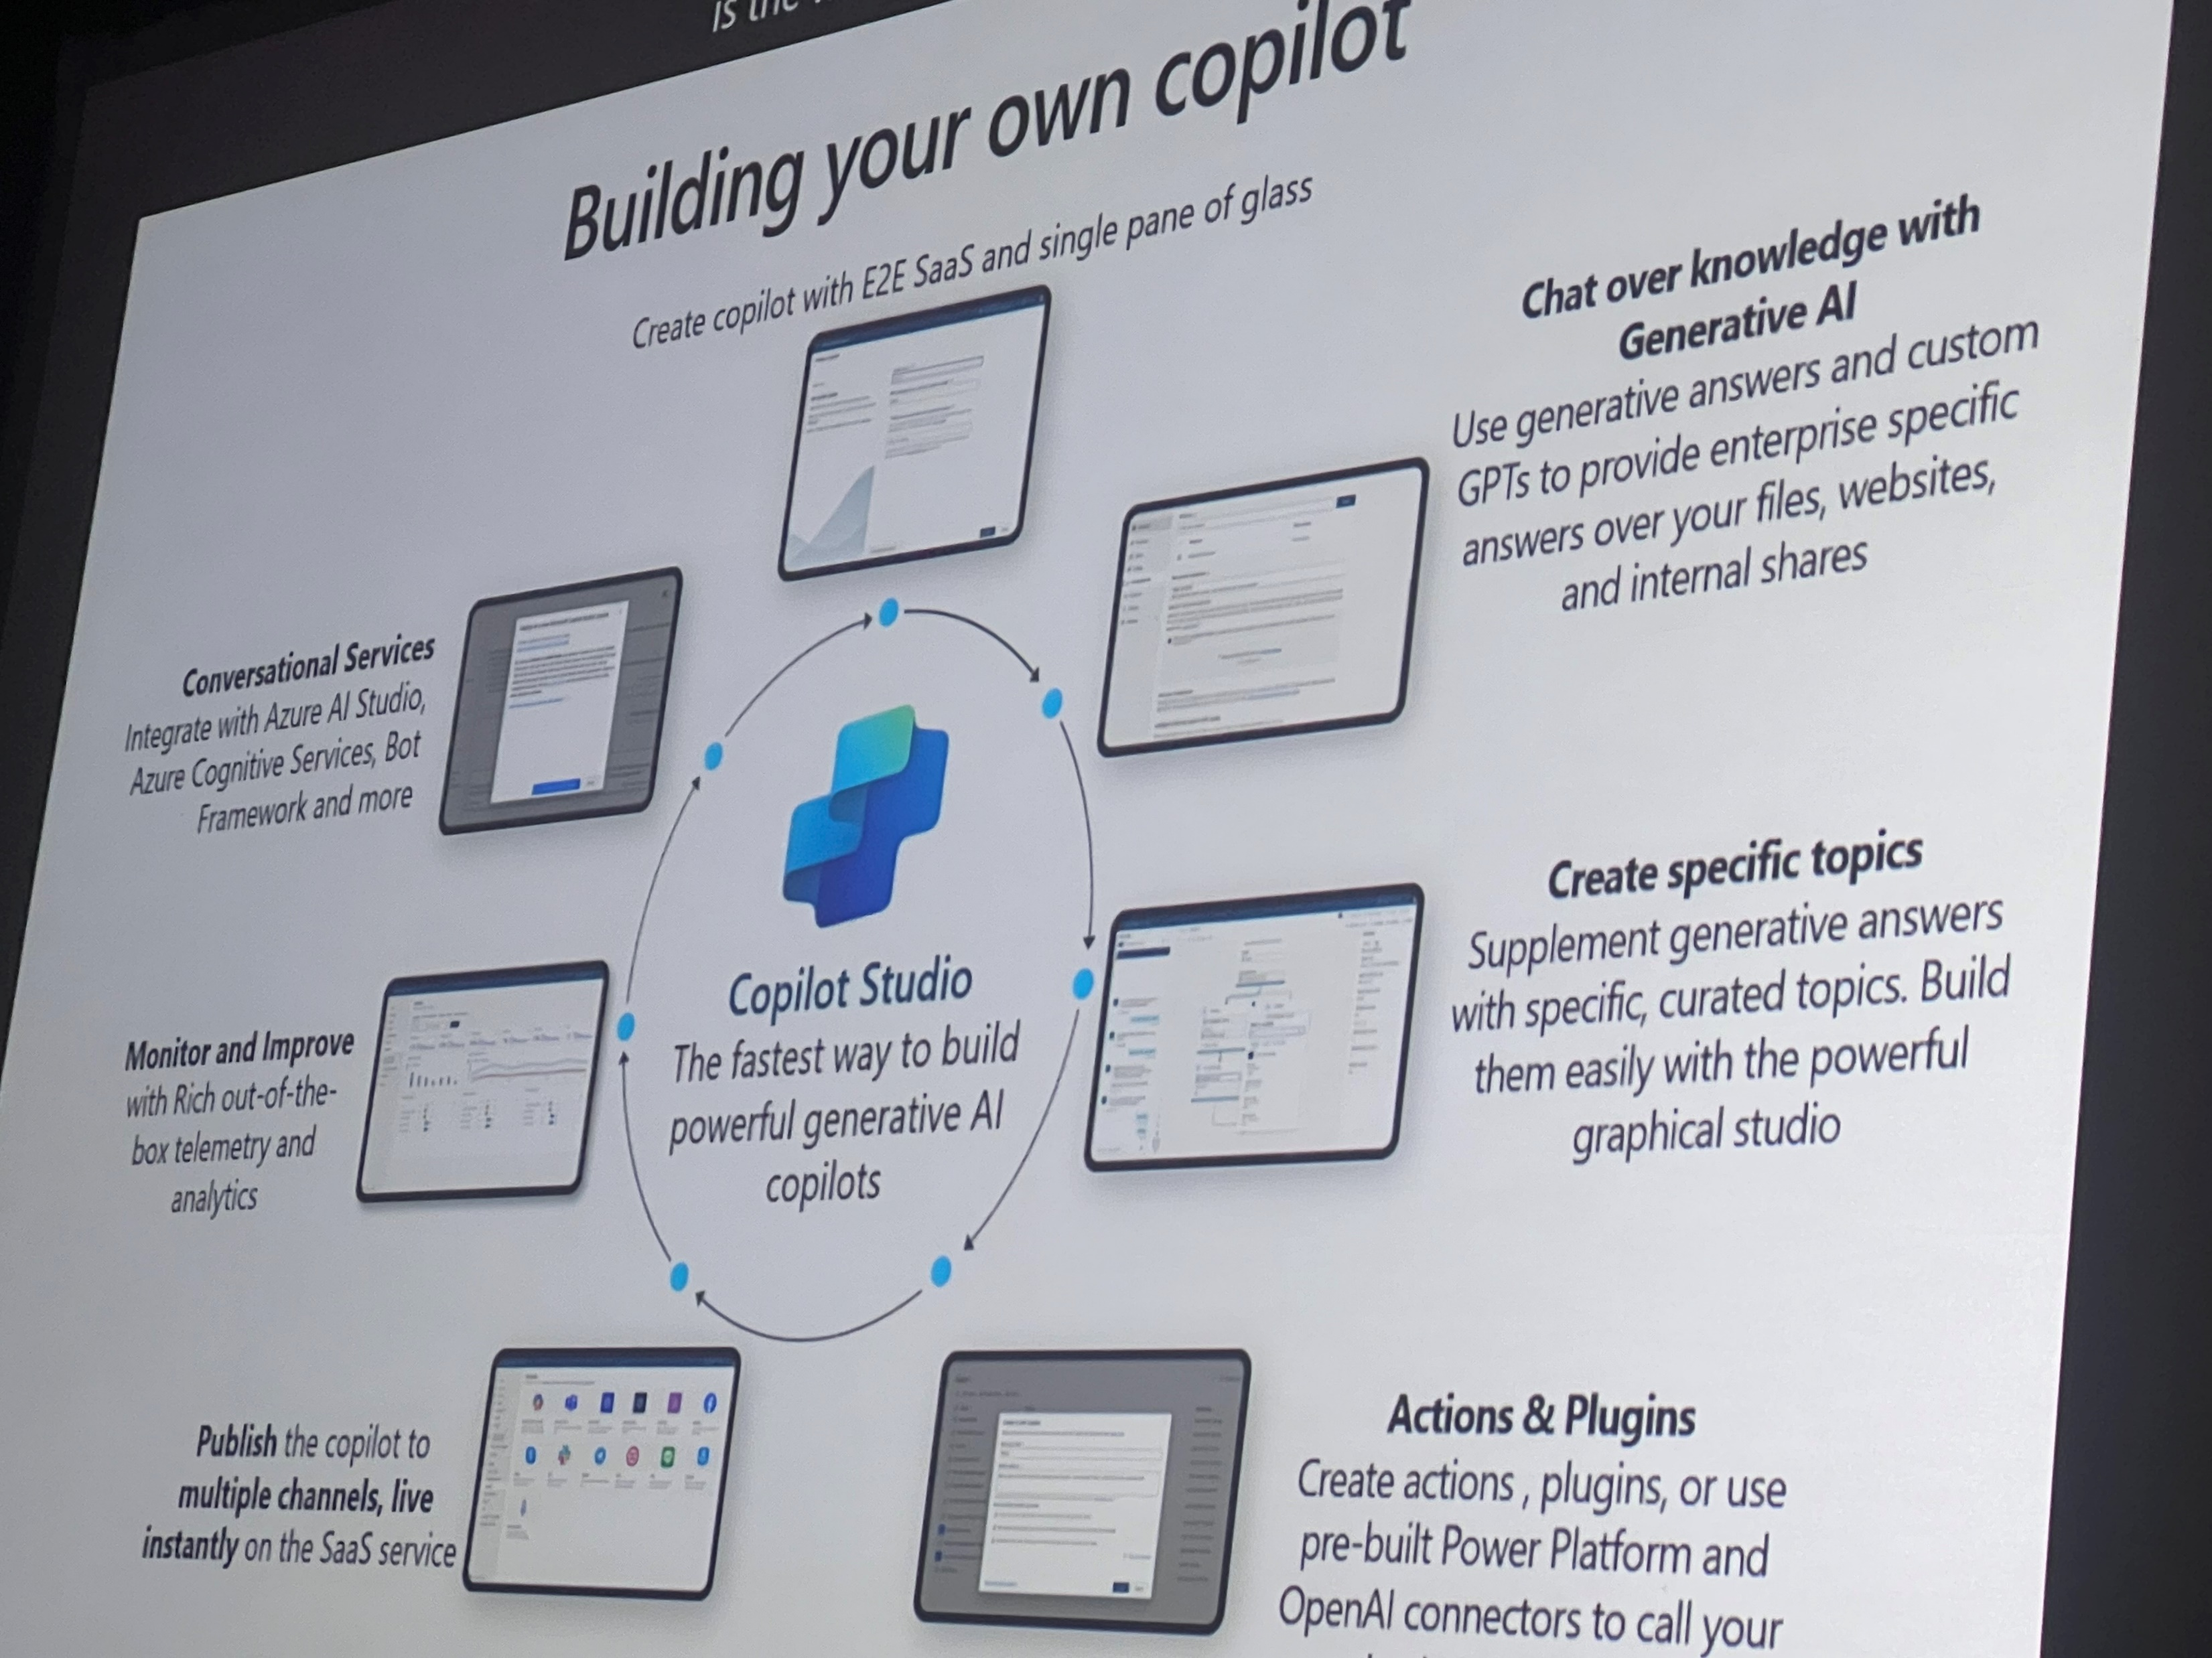
Building and extending Copilots to accelerate productivity

Slide 5
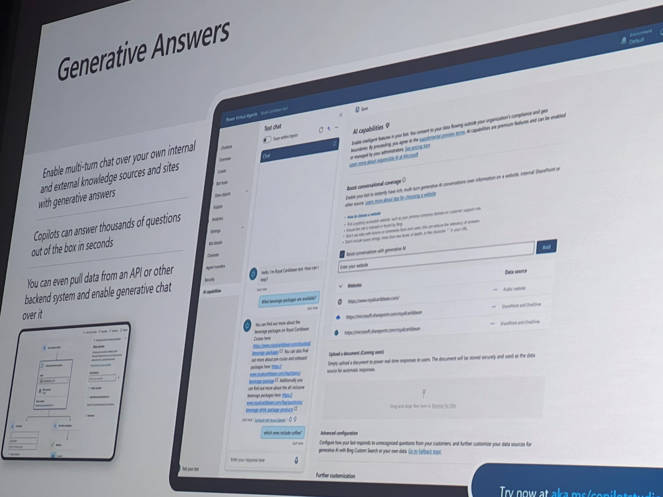
Building and extending Copilots to accelerate productivity

Slide 6
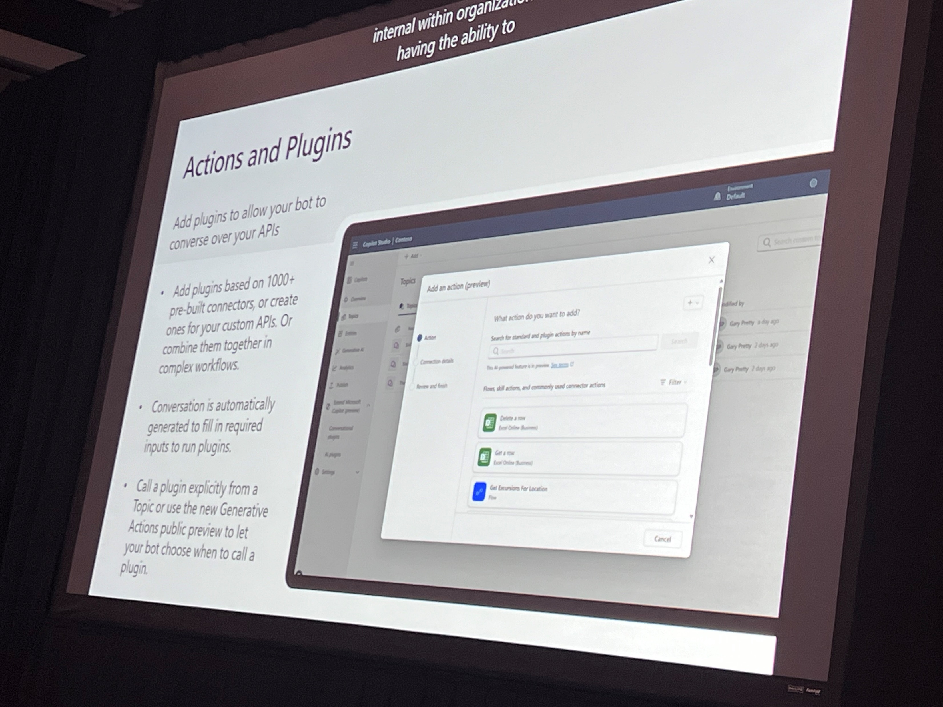
Building and extending Copilots to accelerate productivity

Slide 7
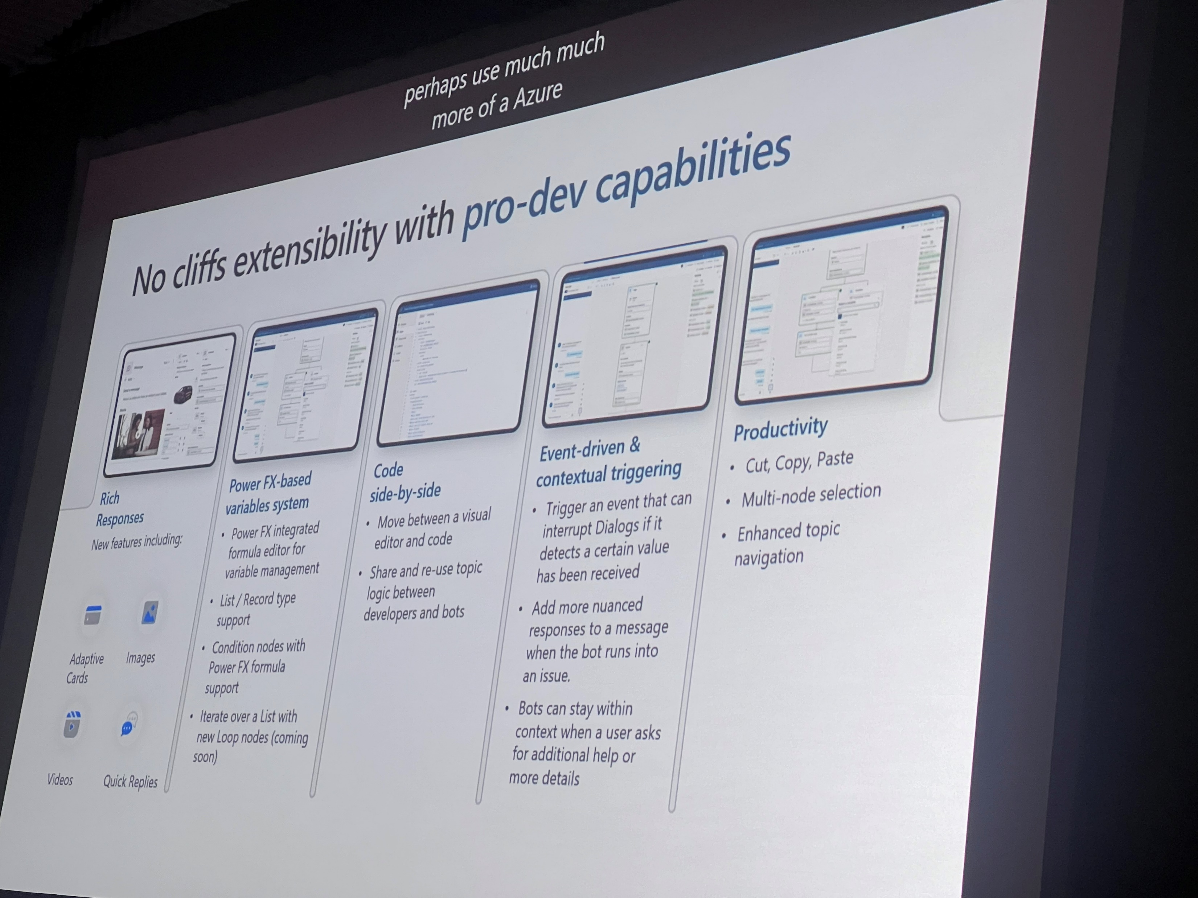
Building and extending Copilots to accelerate productivity

Slide 8
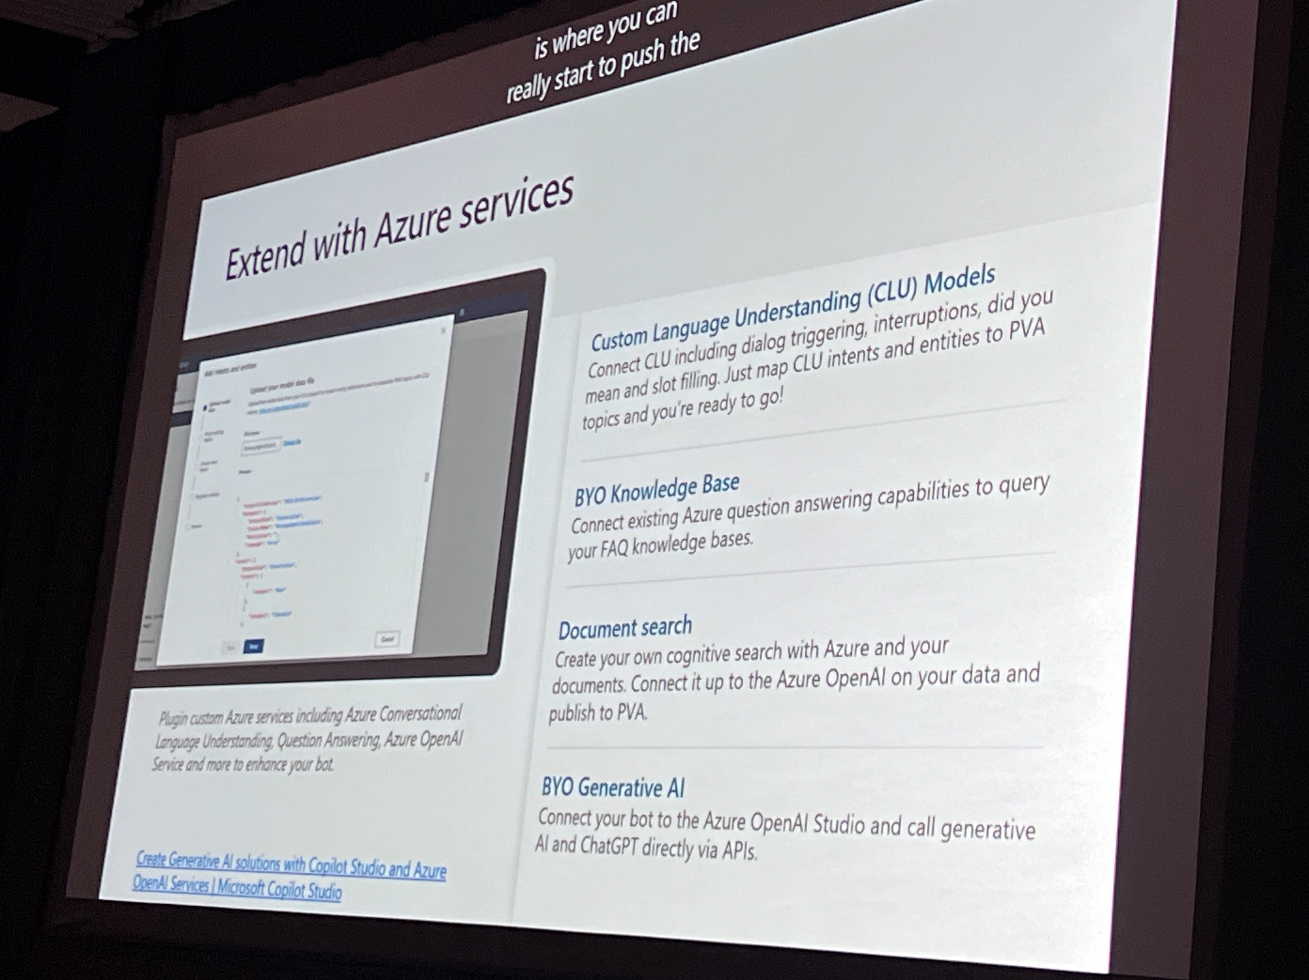
Building and extending Copilots to accelerate productivity

Slide 9
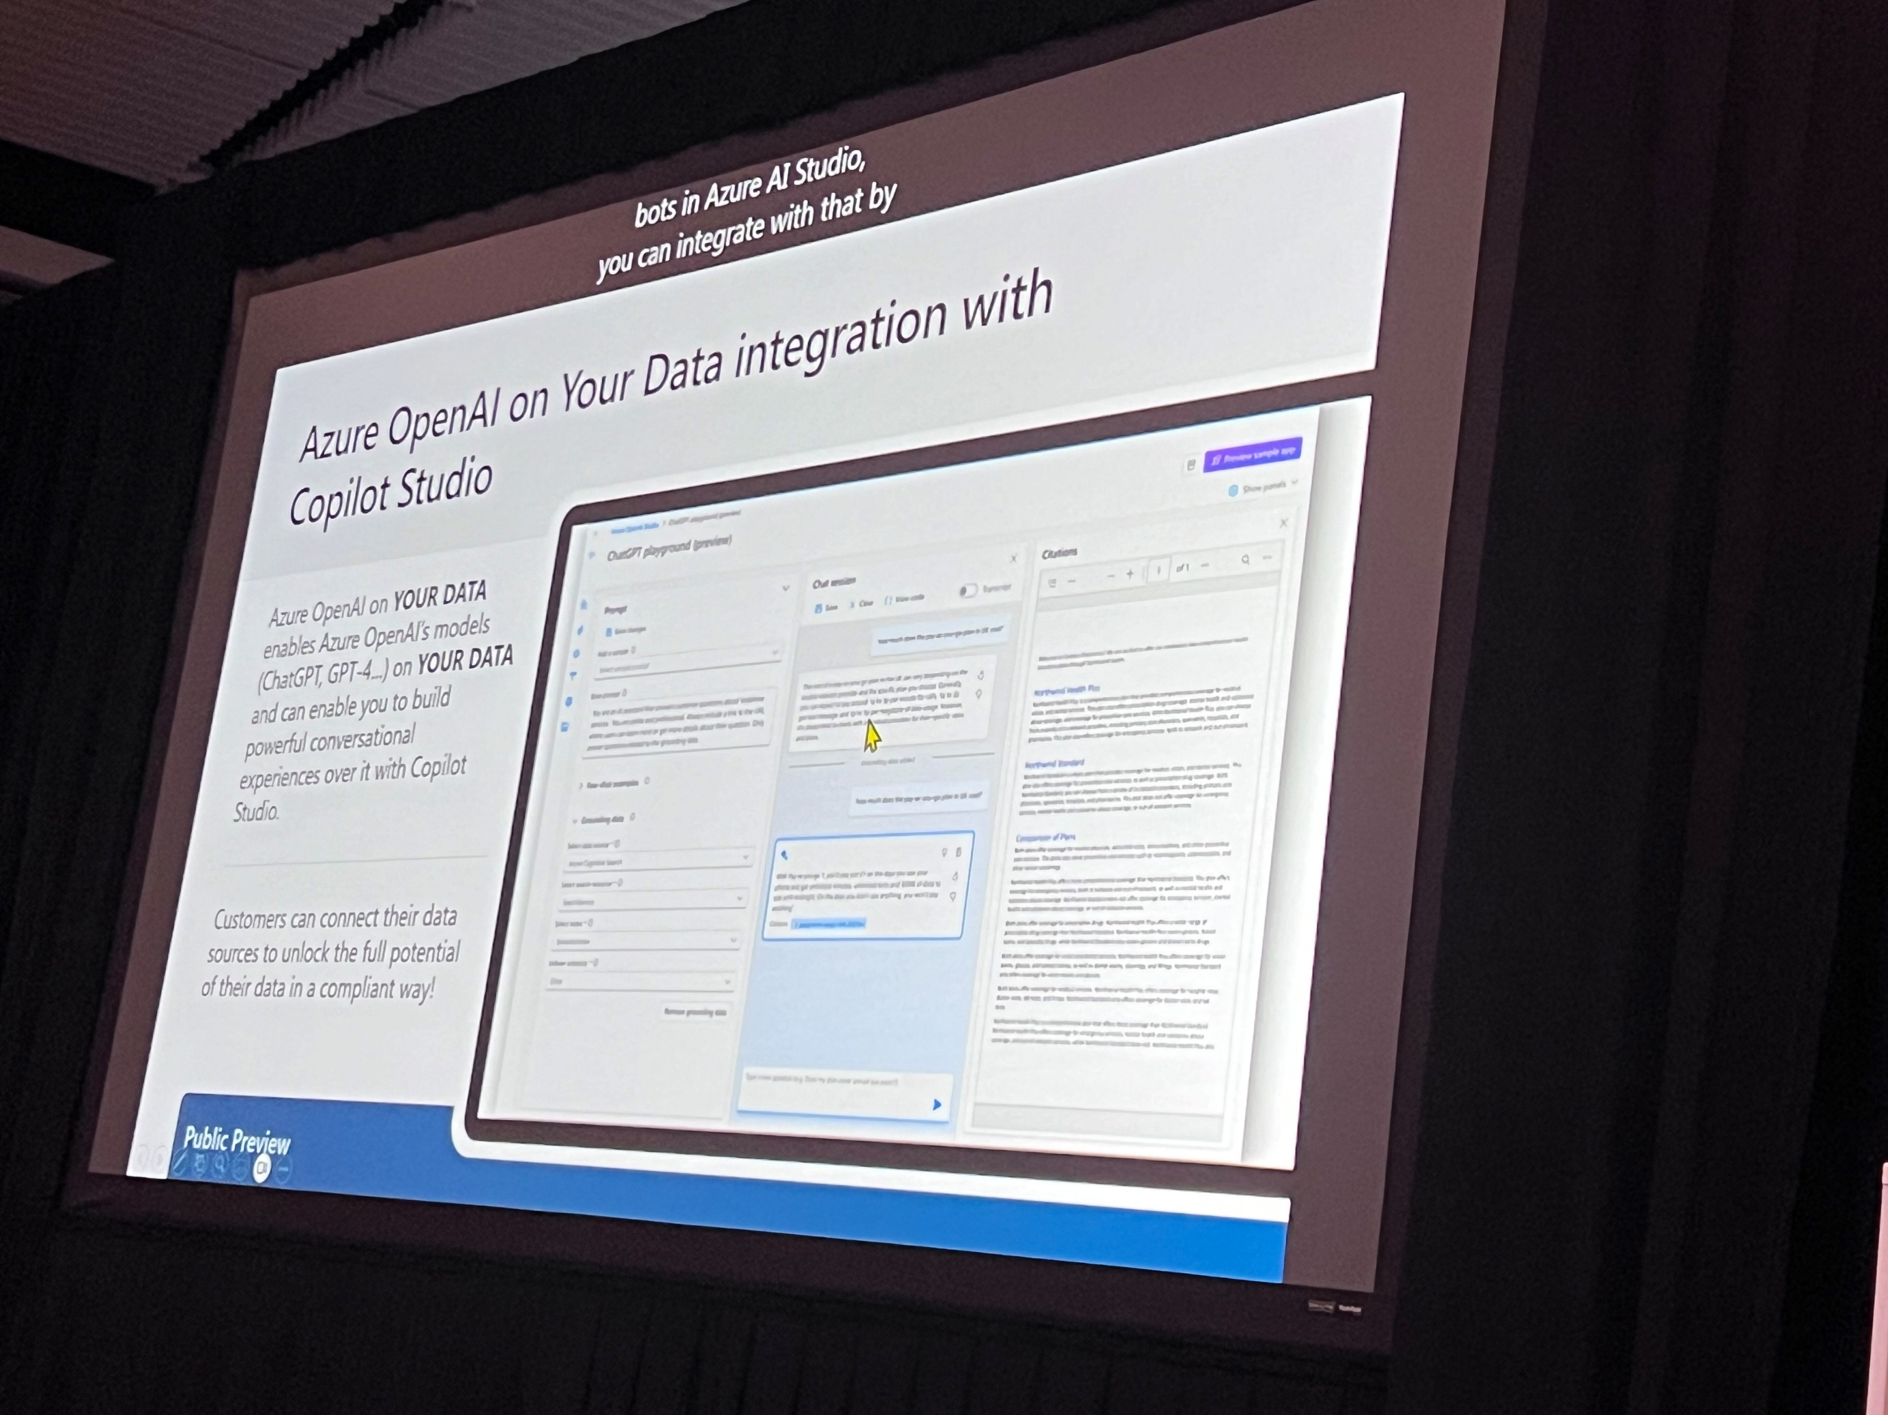
Building and extending Copilots to accelerate productivity

Slide 10
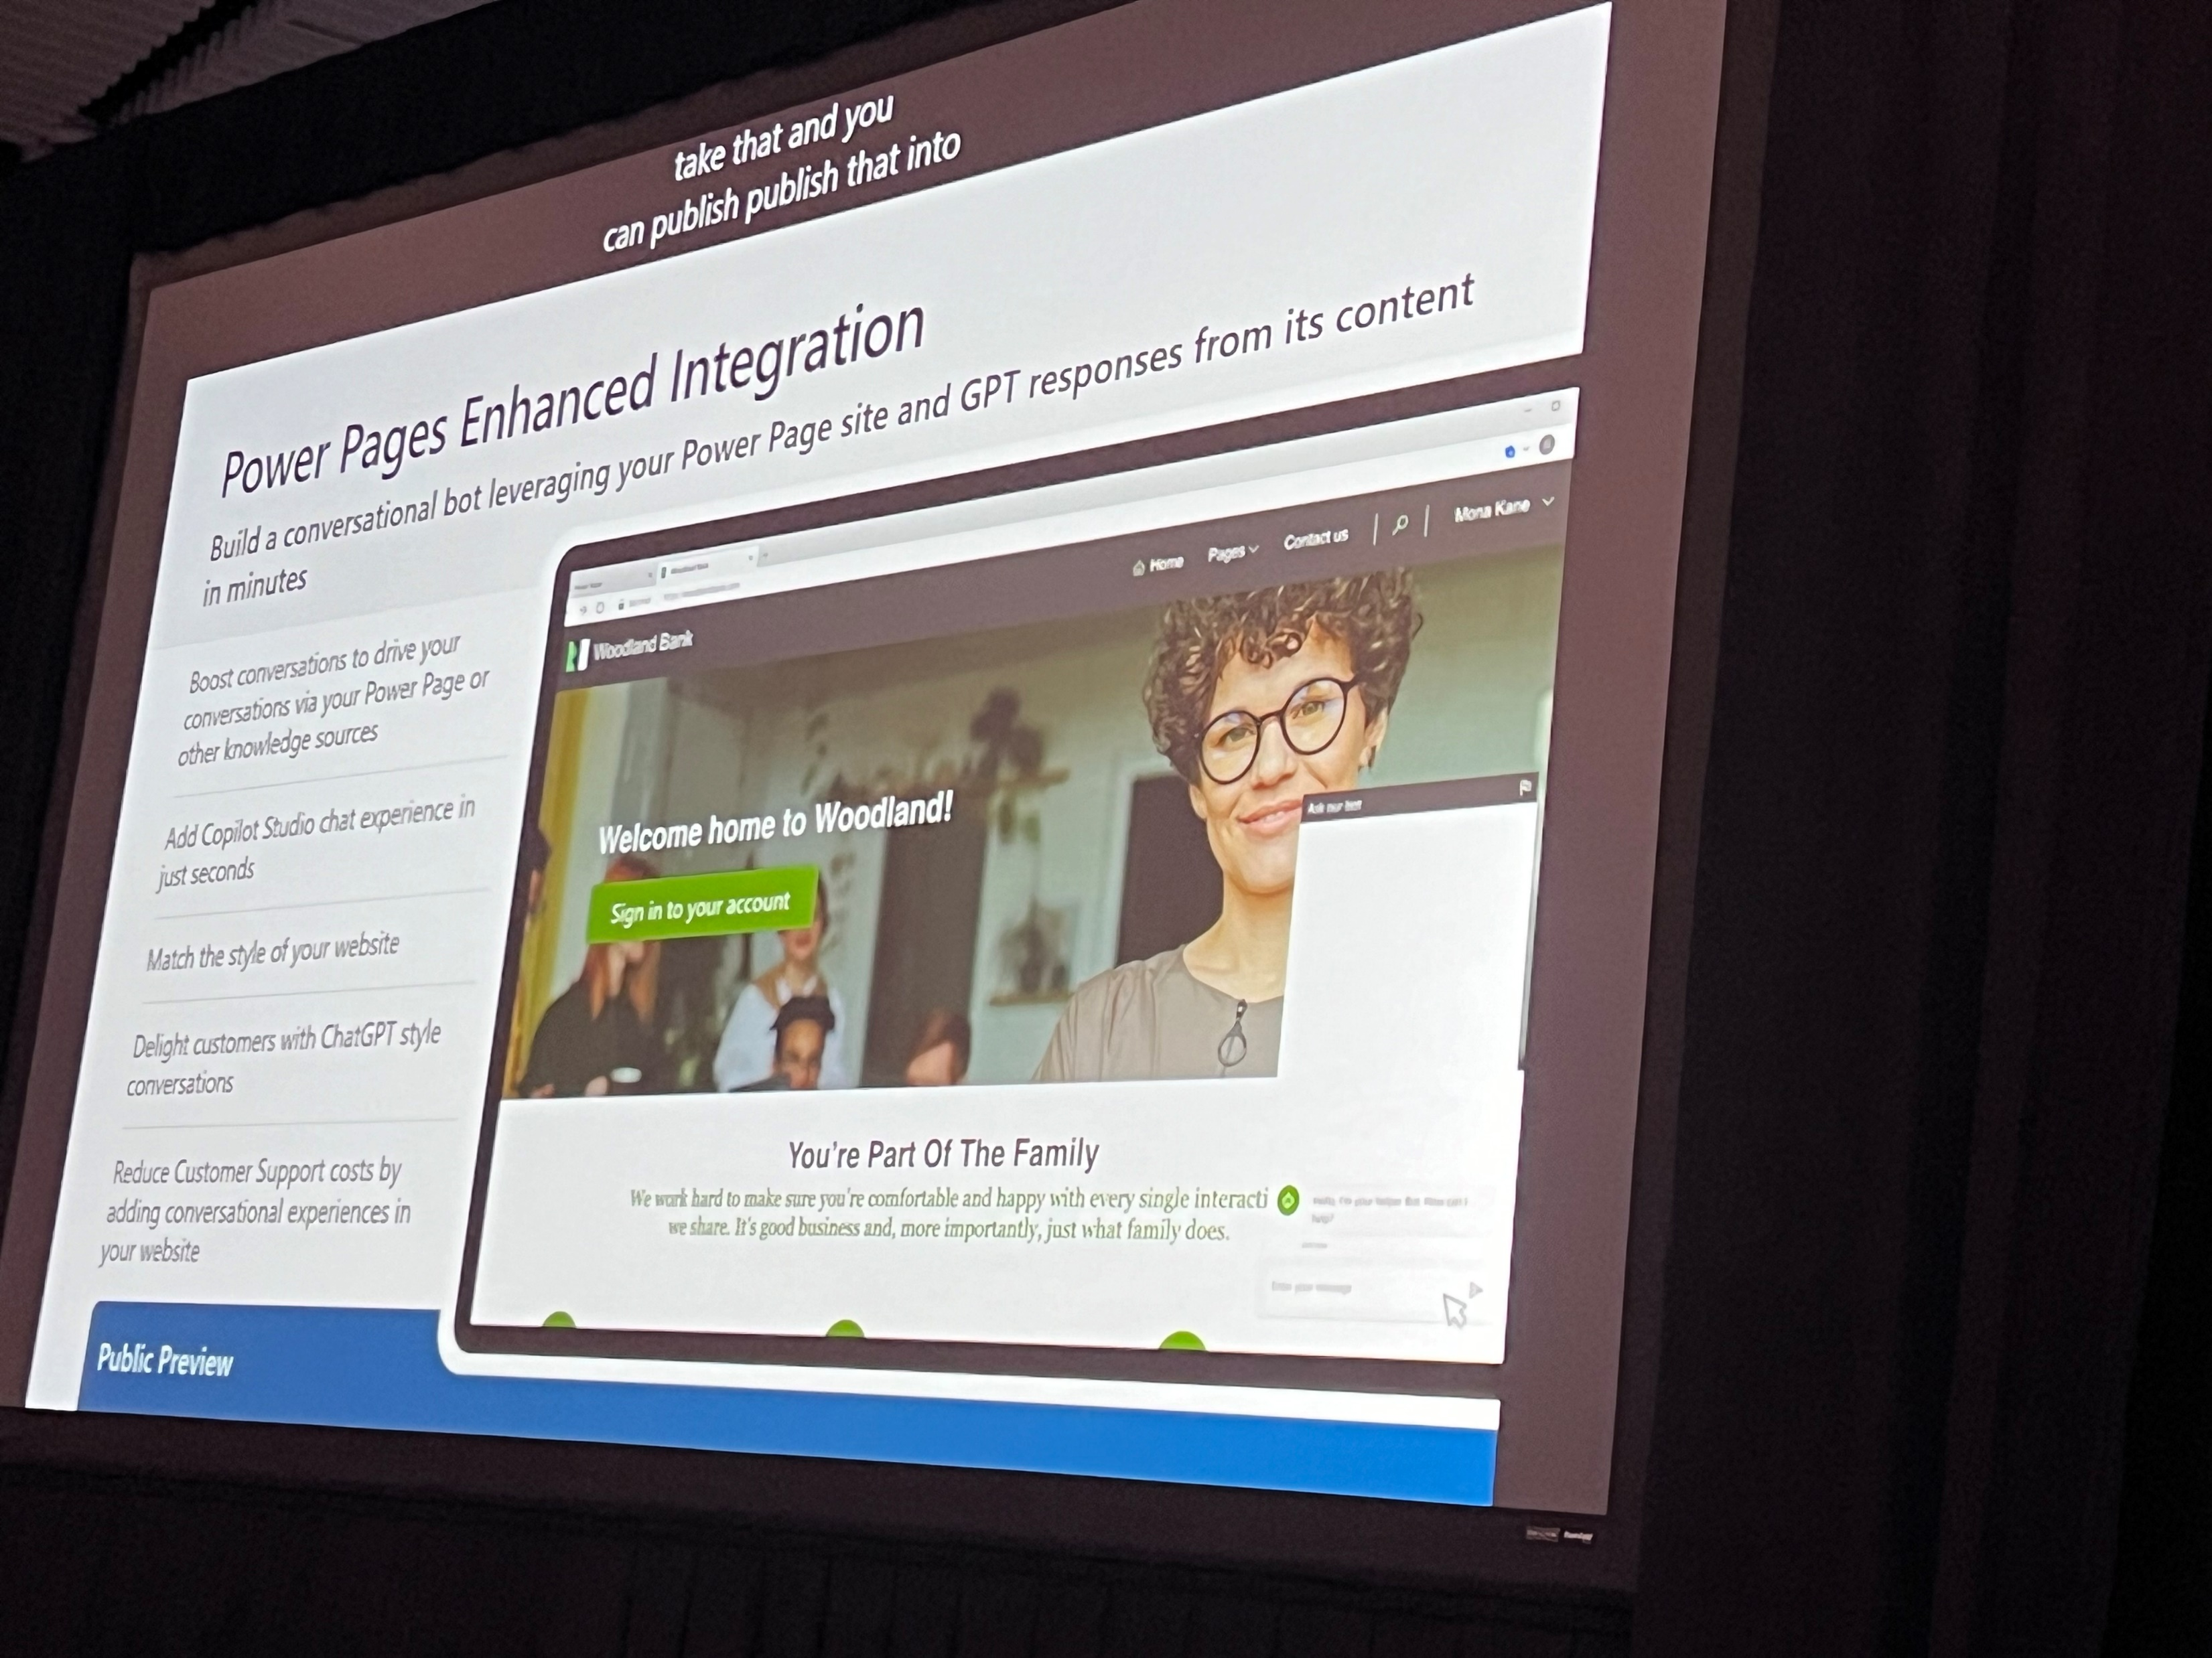
Building and extending Copilots to accelerate productivity

Slide 11
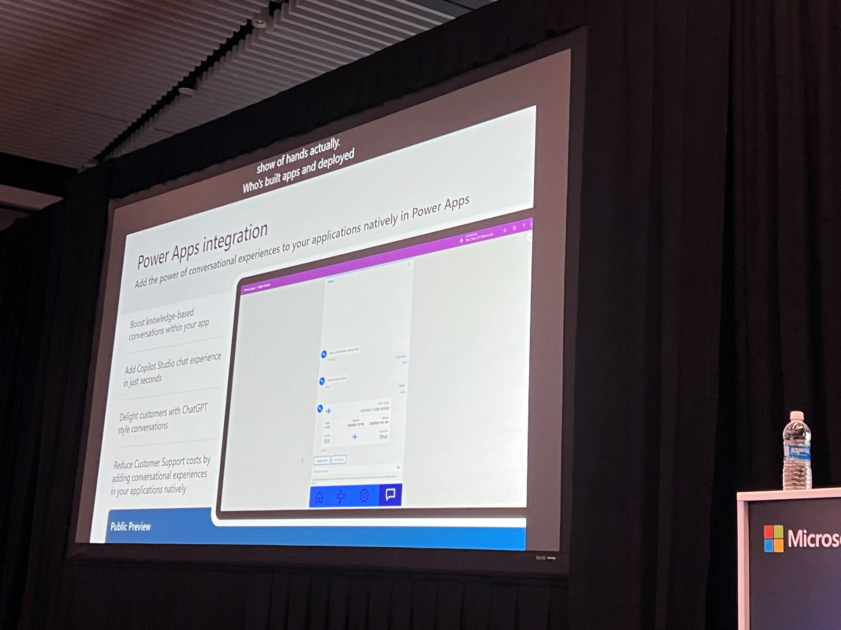
Building and extending Copilots to accelerate productivity

Slide 12
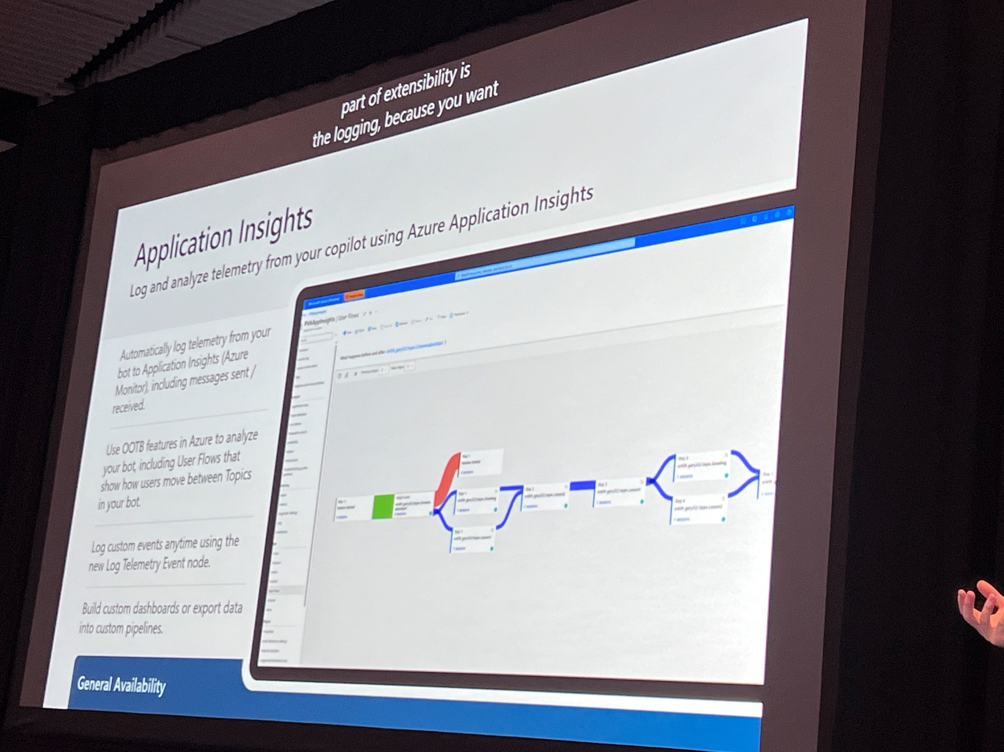
Building and extending Copilots to accelerate productivity

Slide 13
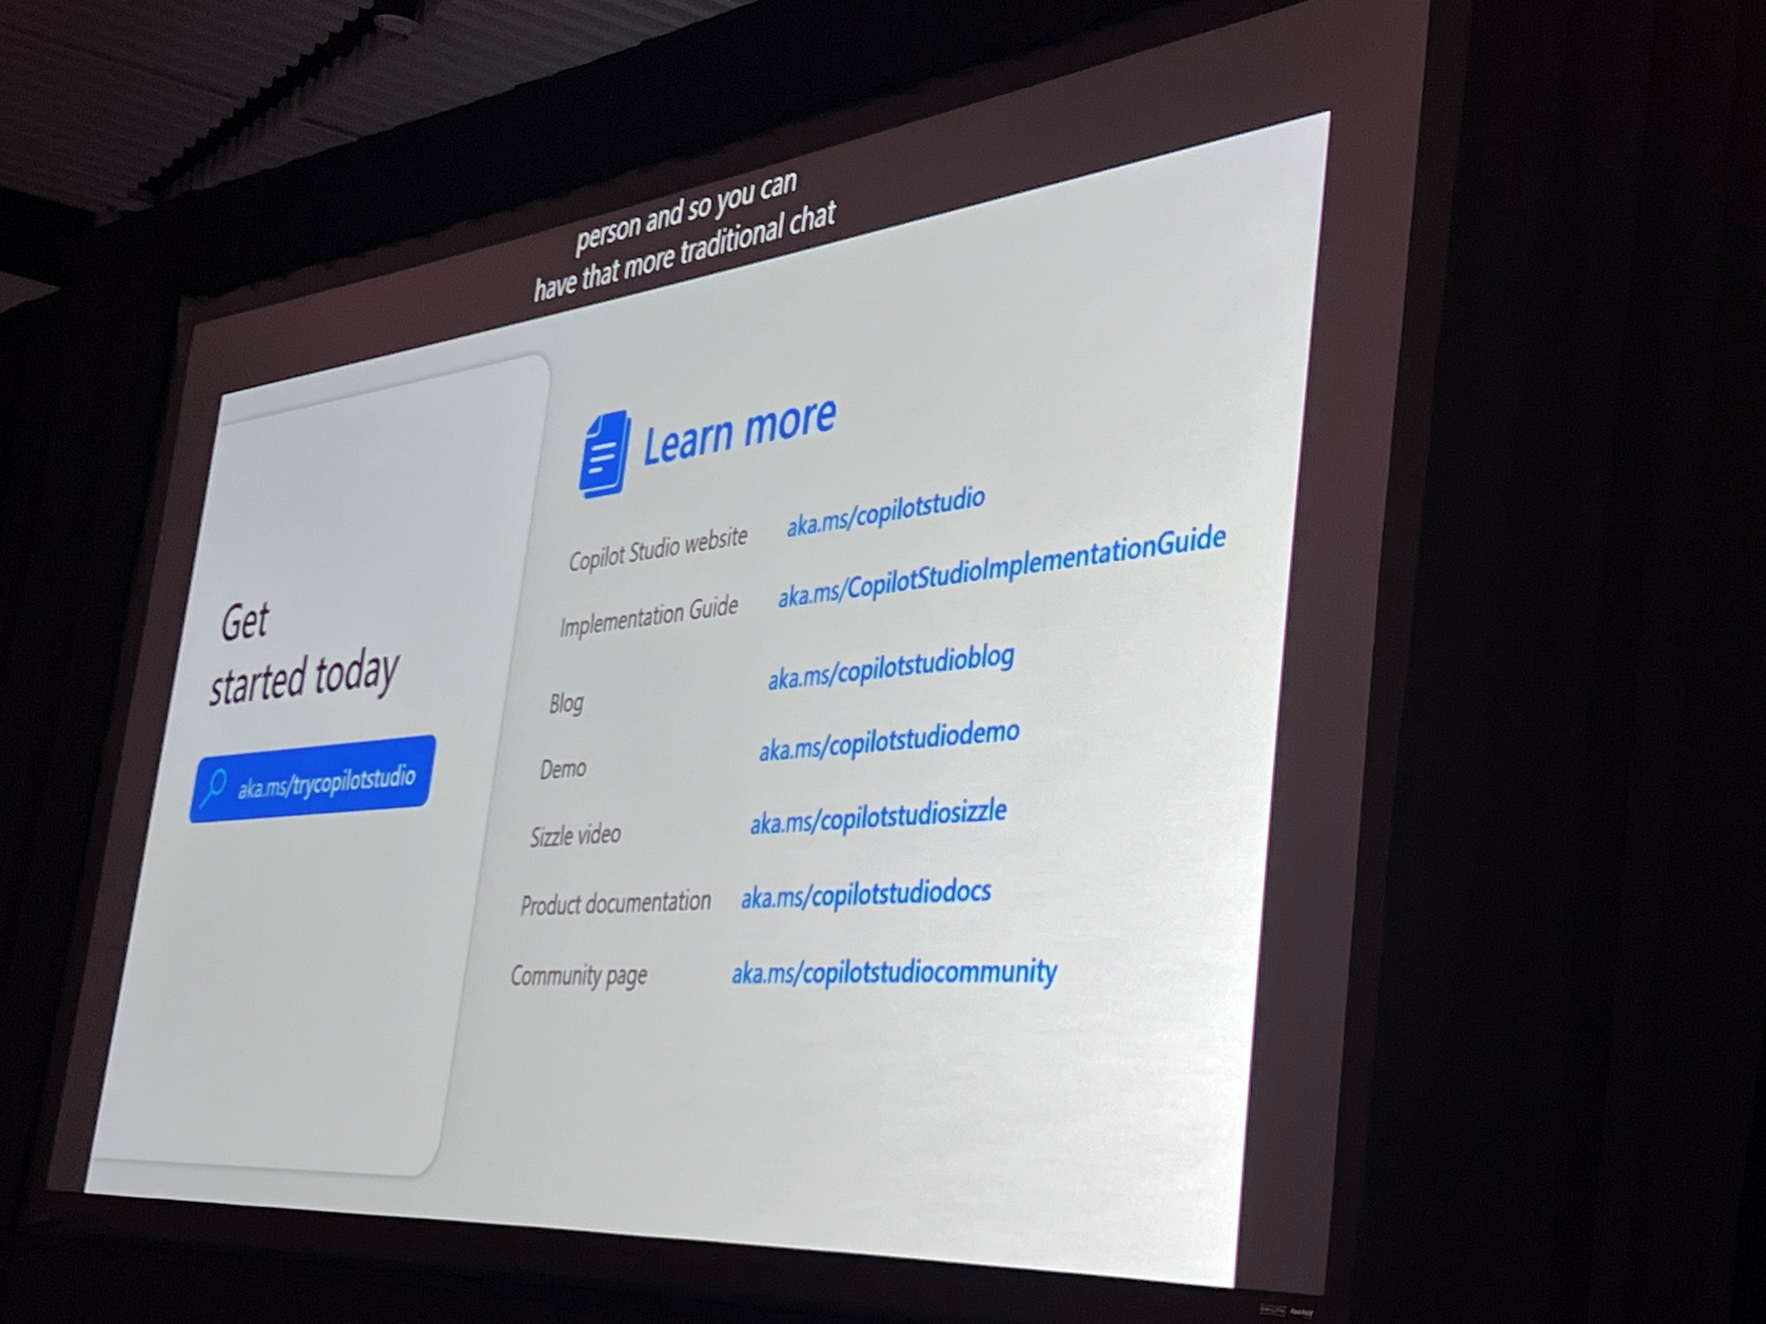
Building and extending Copilots to accelerate productivity

Slide 14
Build your own Copilots with Microsoft Copilot Studio

Slide 15
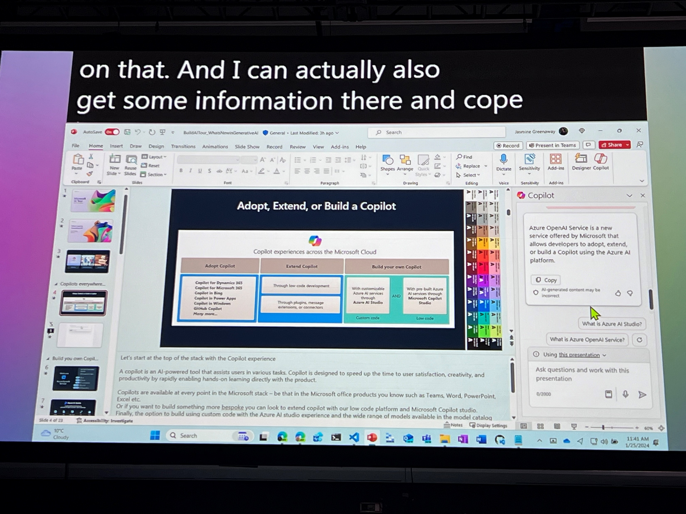
Building and extending Copilots to accelerate productivity

Slide 16
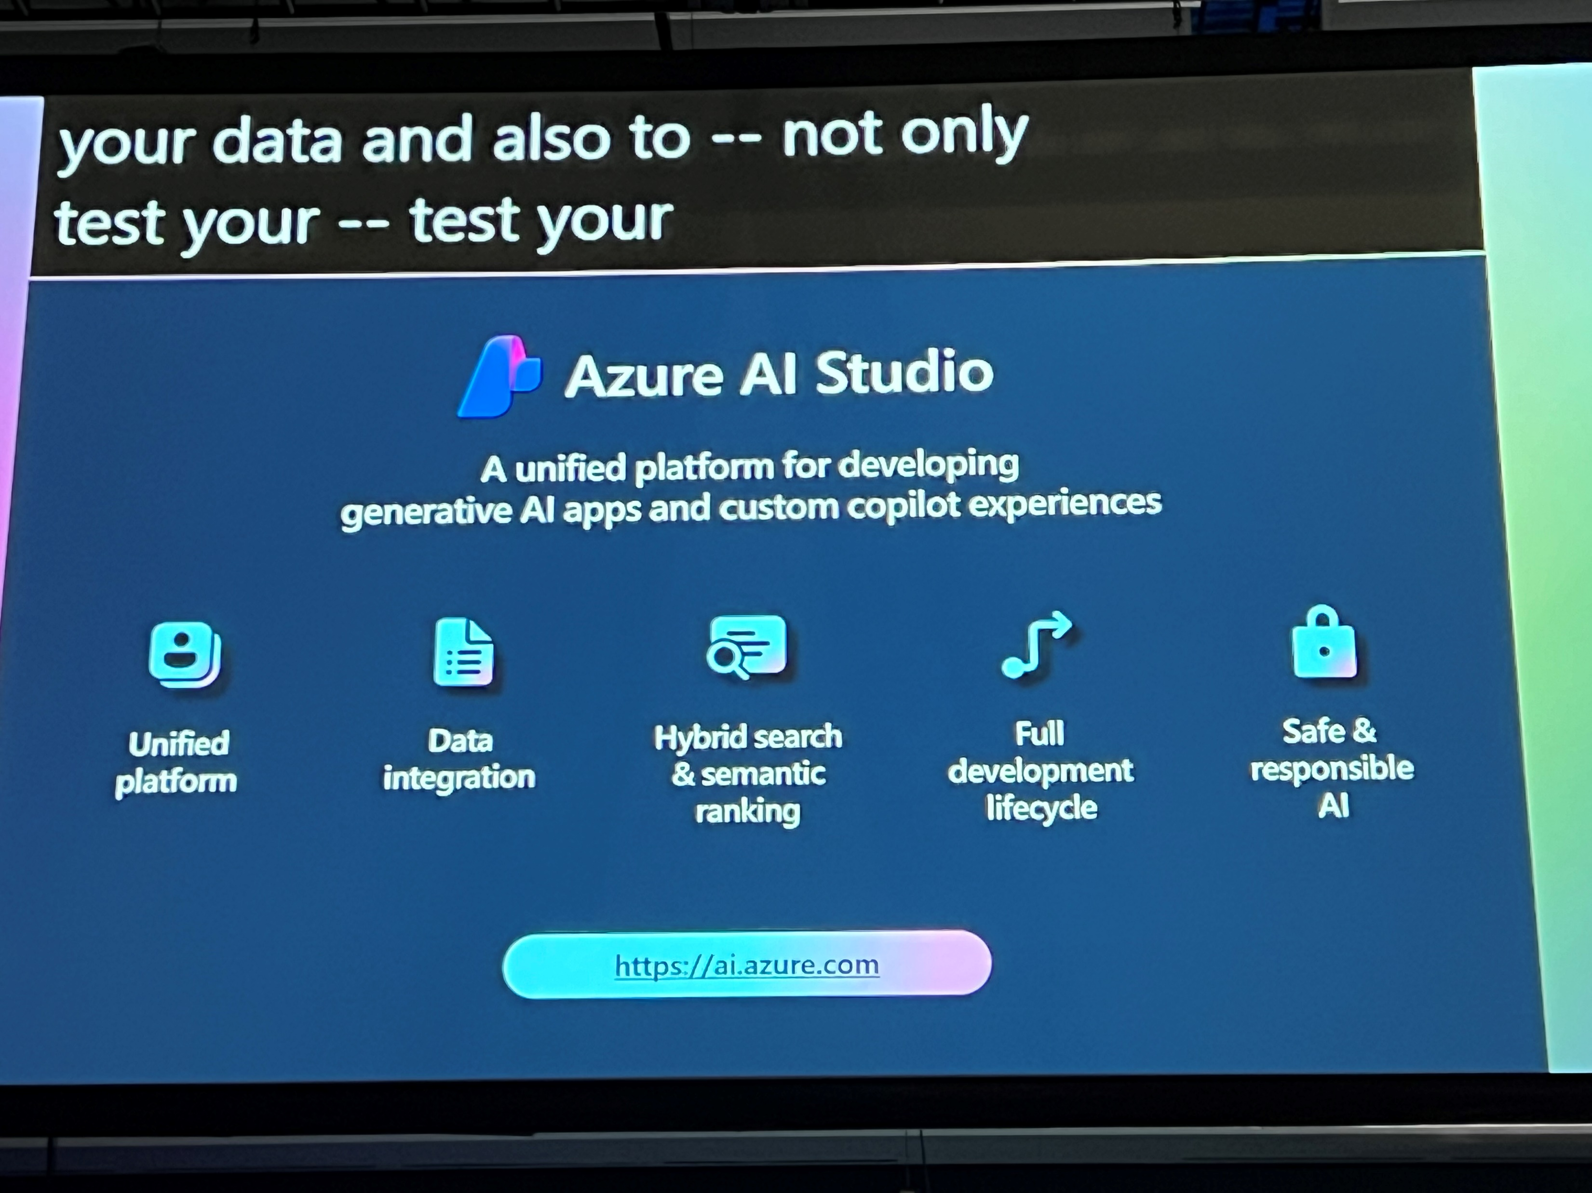
Building and extending Copilots to accelerate productivity

Slide 17
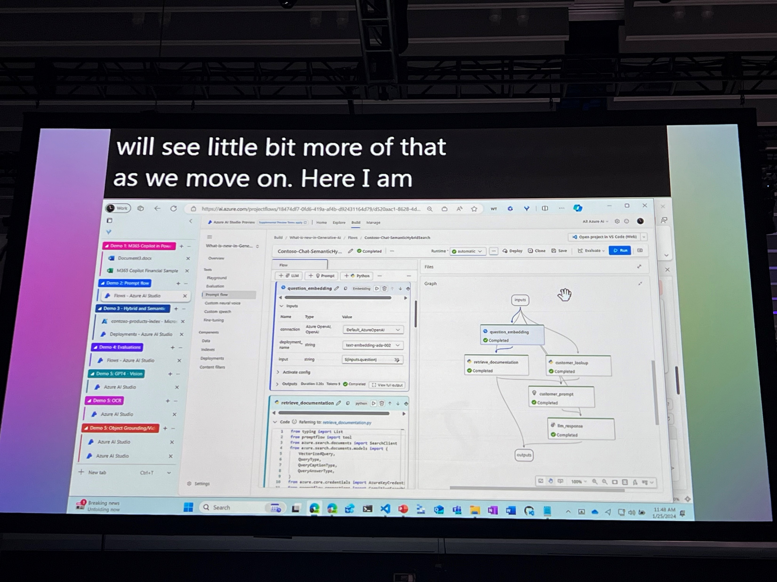
Building and extending Copilots to accelerate productivity

Slide 18
Build your RAG Application in Prompt flow in Azure AI Studio

Slide 19
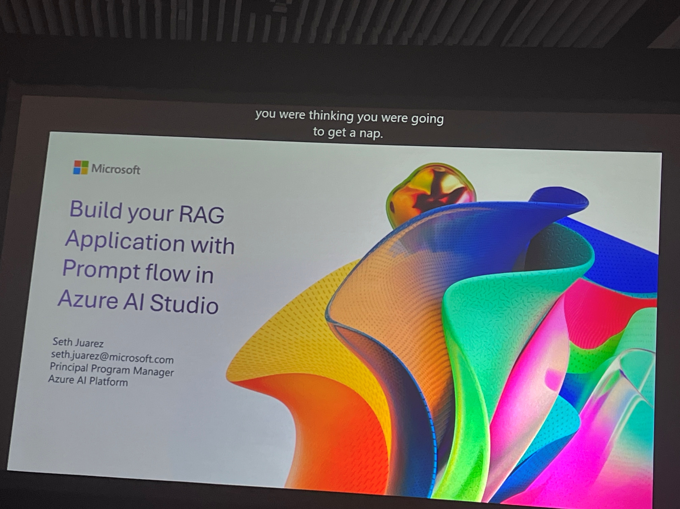
Build your RAG Application in Prompt flow in Azure AI Studio

Slide 20
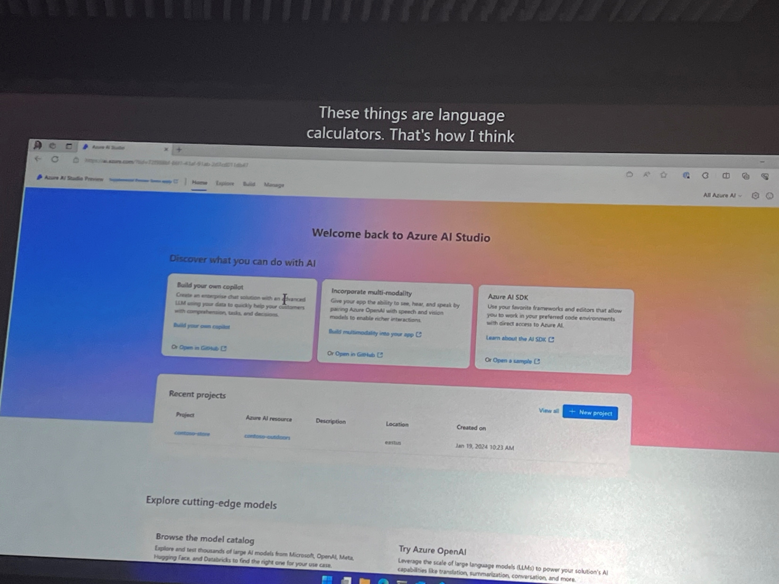
Build your RAG Application in Prompt flow in Azure AI Studio

Slide 21
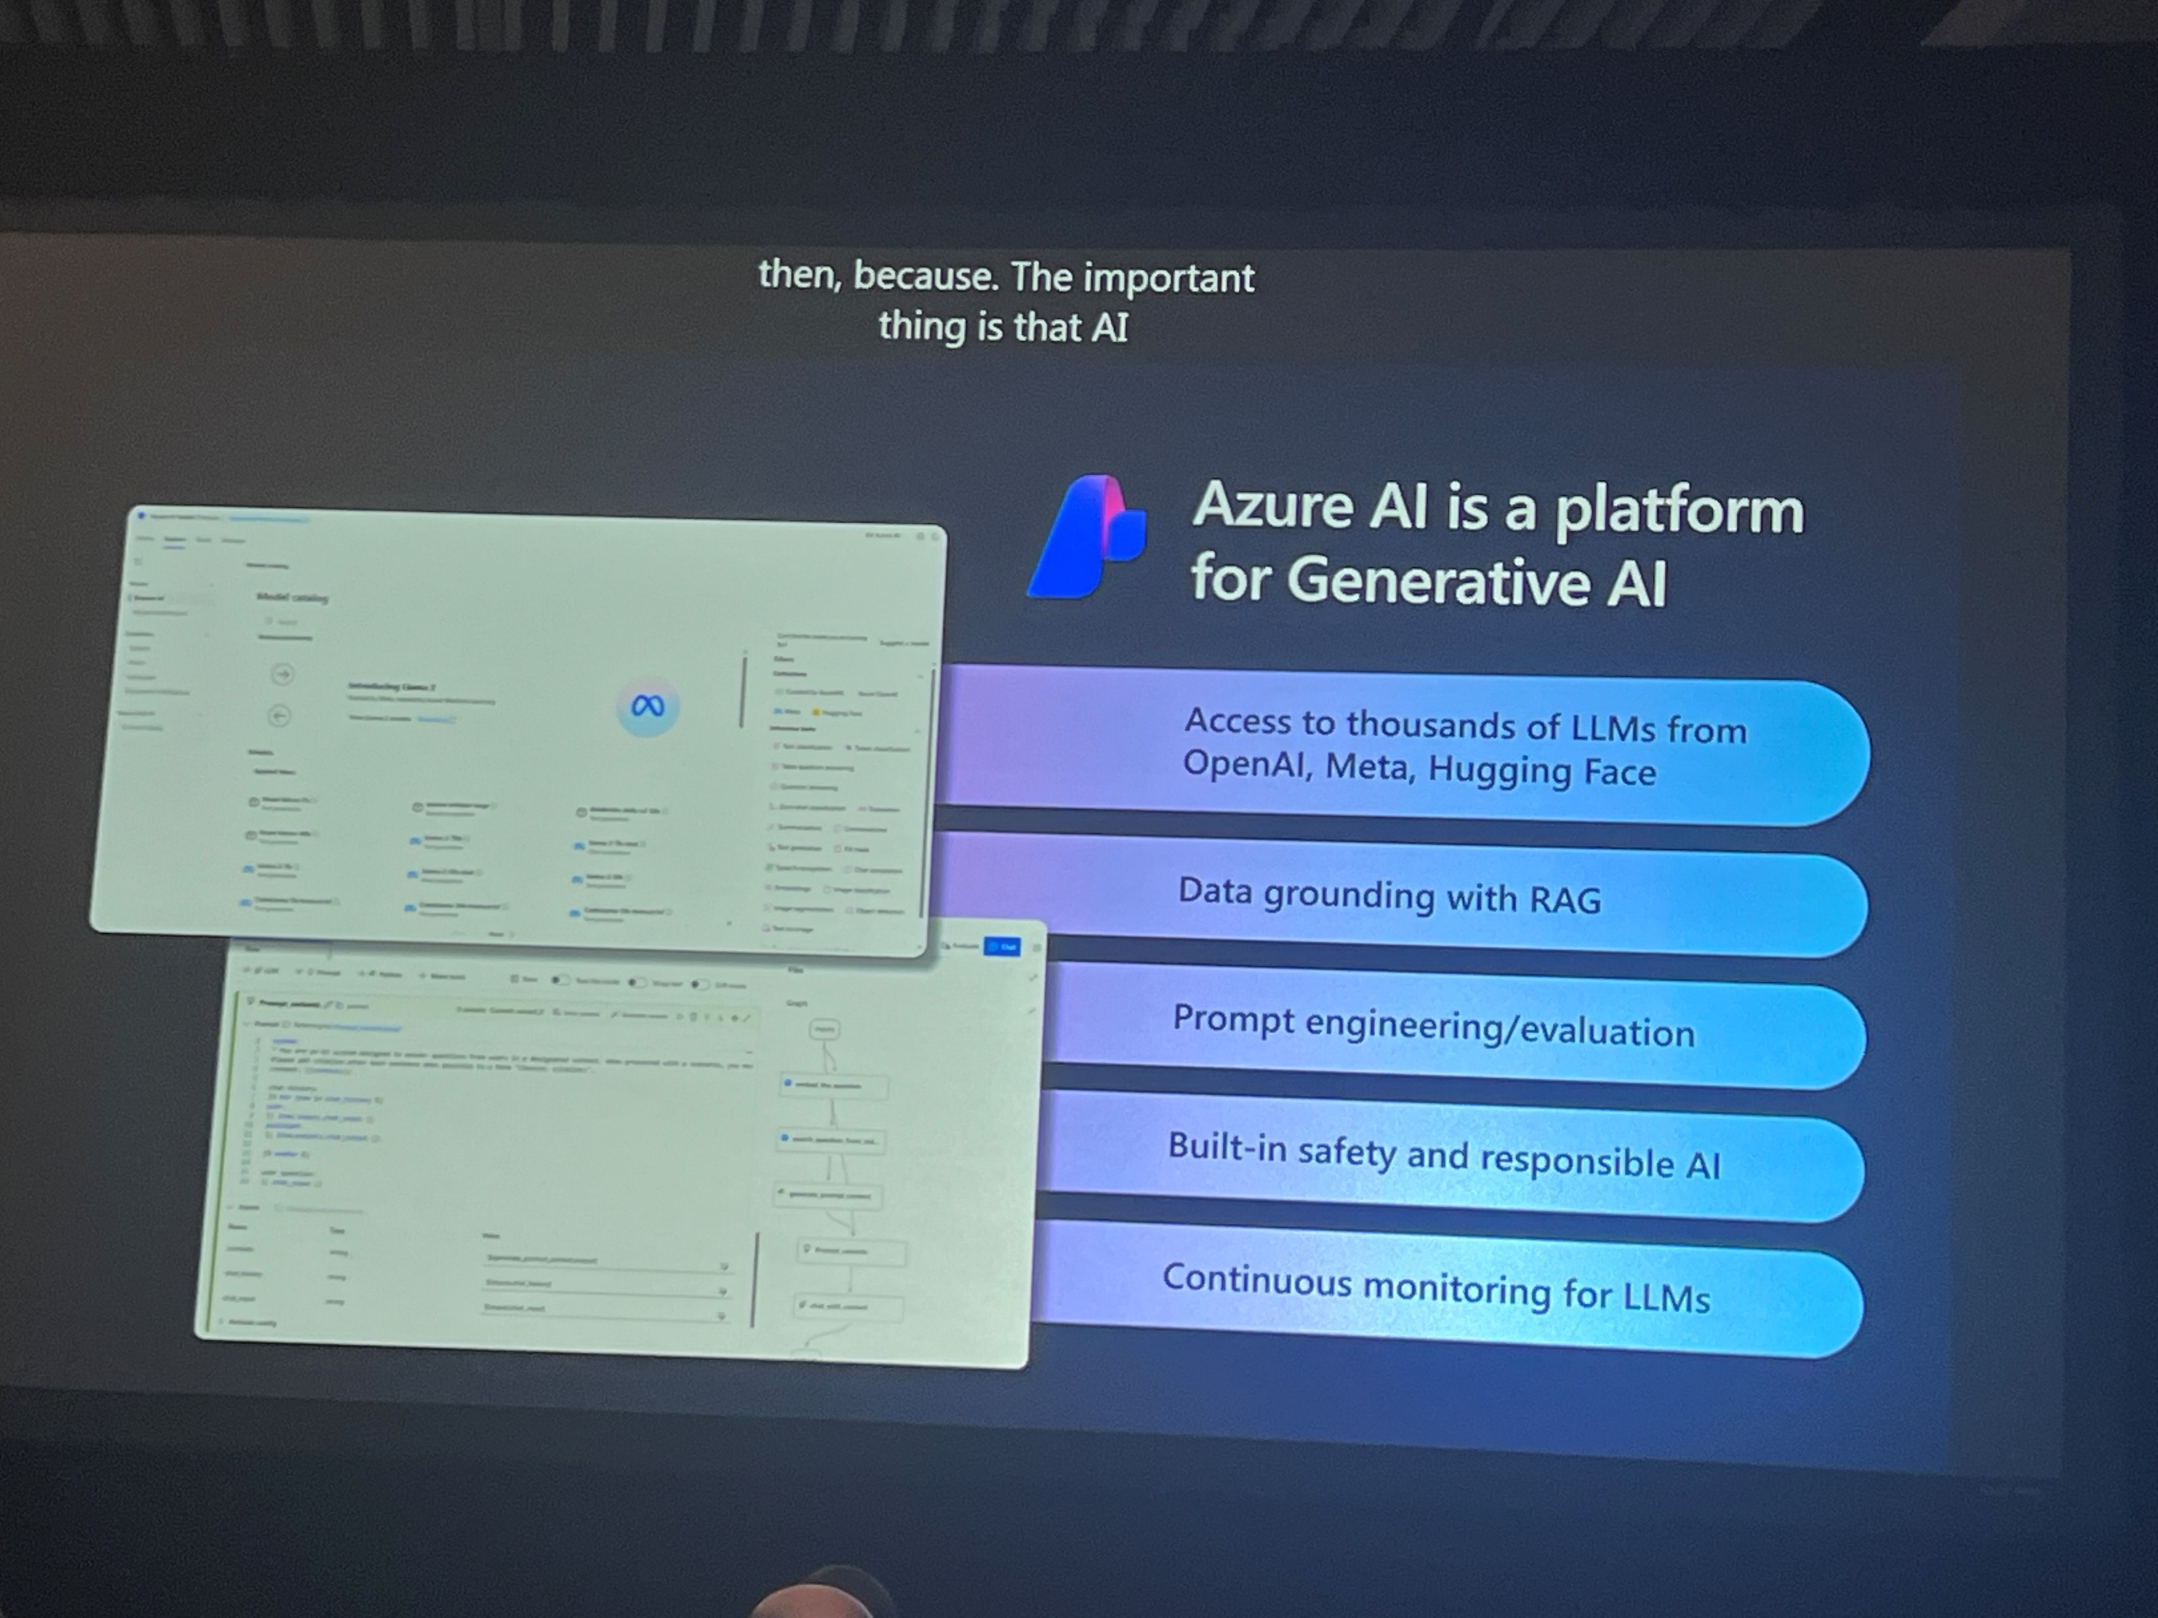
Build your RAG Application in Prompt flow in Azure AI Studio

Slide 22
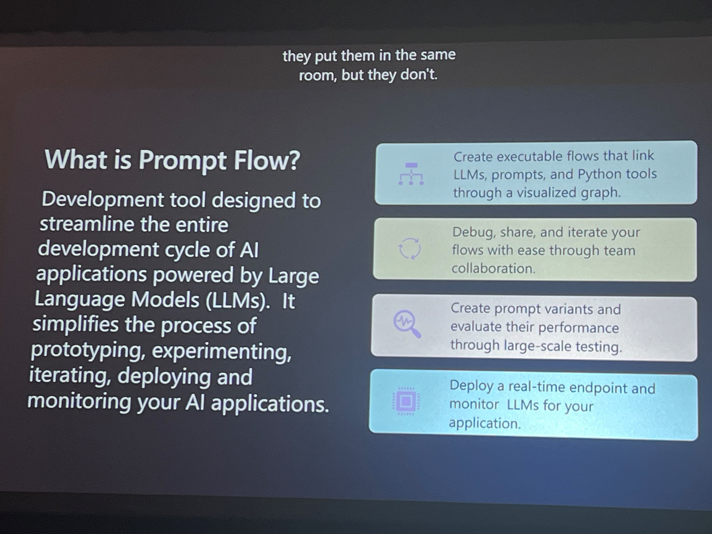
Build your RAG Application in Prompt flow in Azure AI Studio

Slide 23
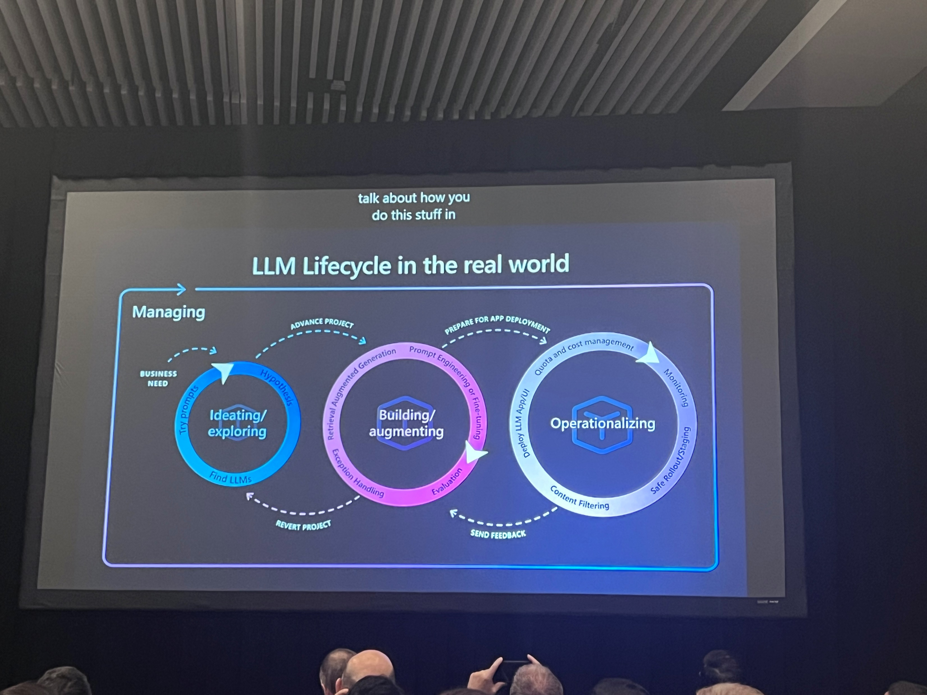
Build your RAG Application in Prompt flow in Azure AI Studio

Slide 24
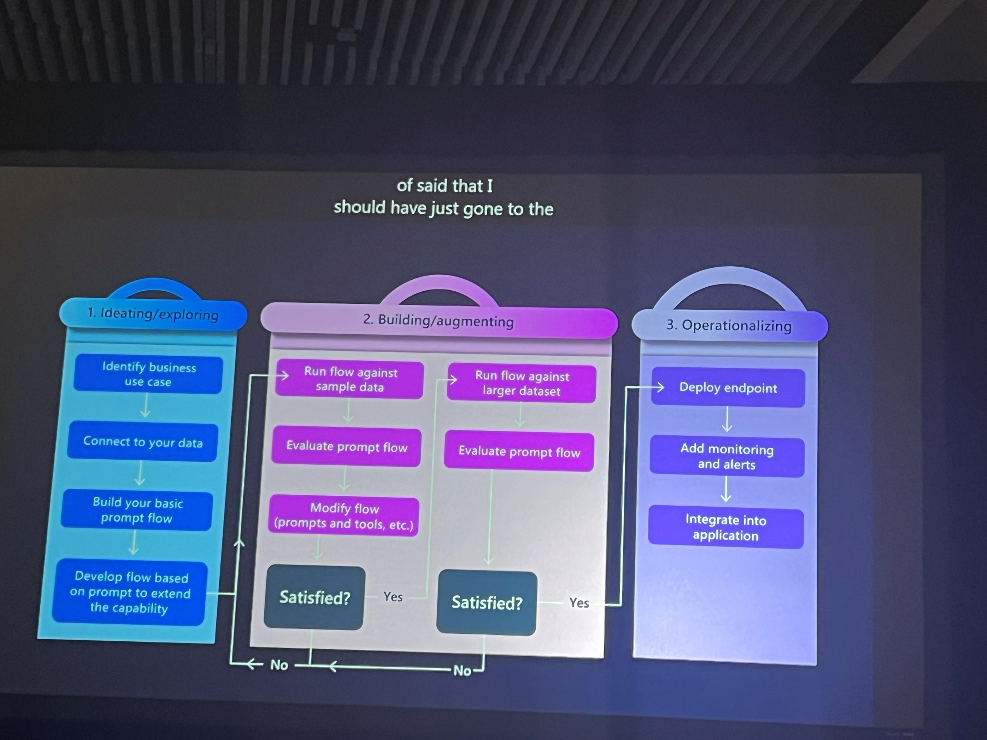
Build your RAG Application in Prompt flow in Azure AI Studio

Slide 25
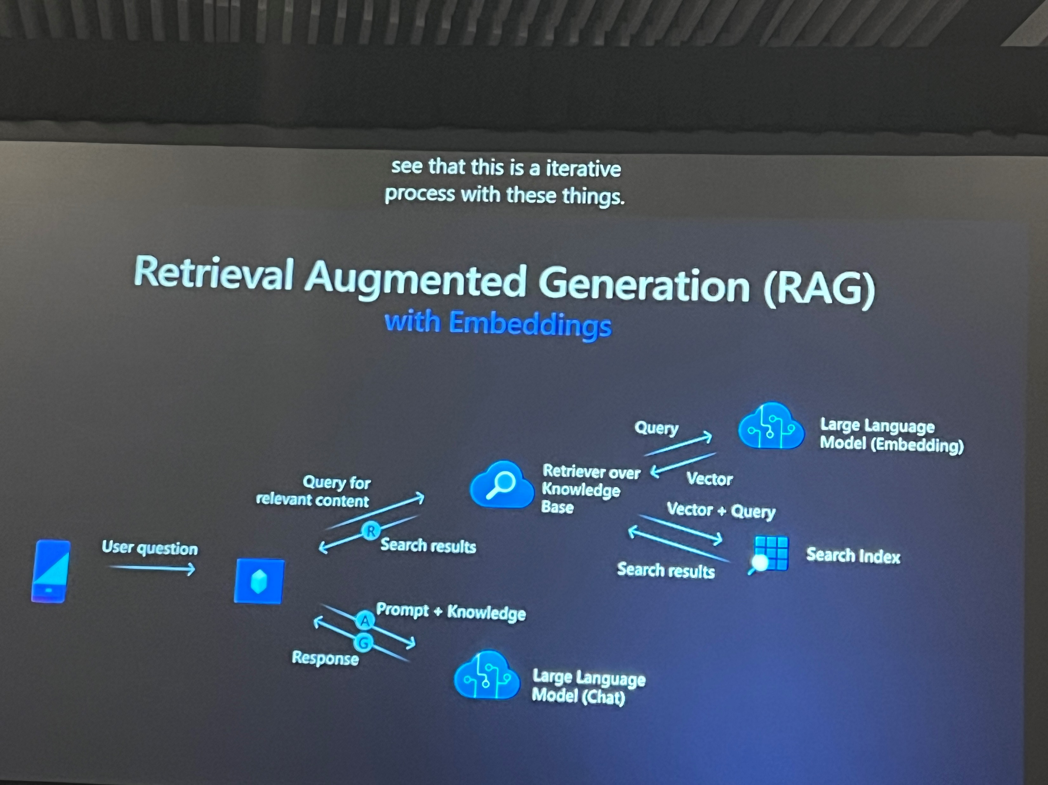
Build your RAG Application in Prompt flow in Azure AI Studio

Slide 26
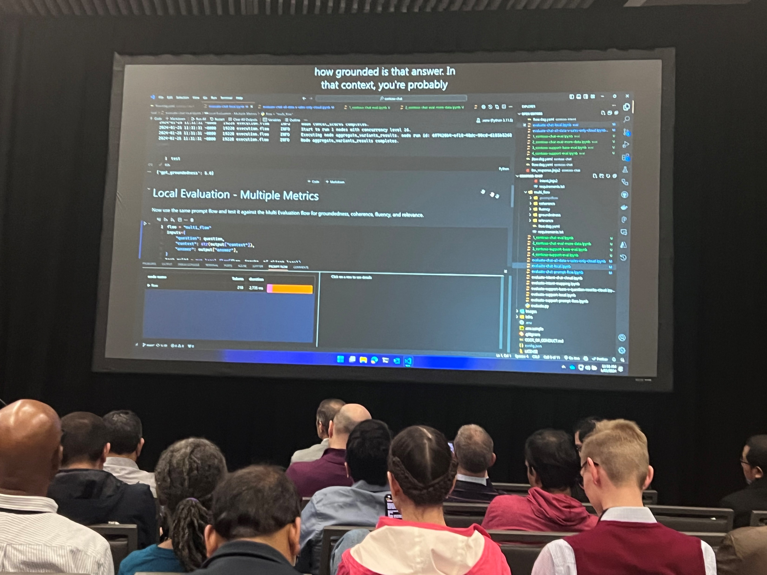
Build your RAG Application in Prompt flow in Azure AI Studio

Slide 27
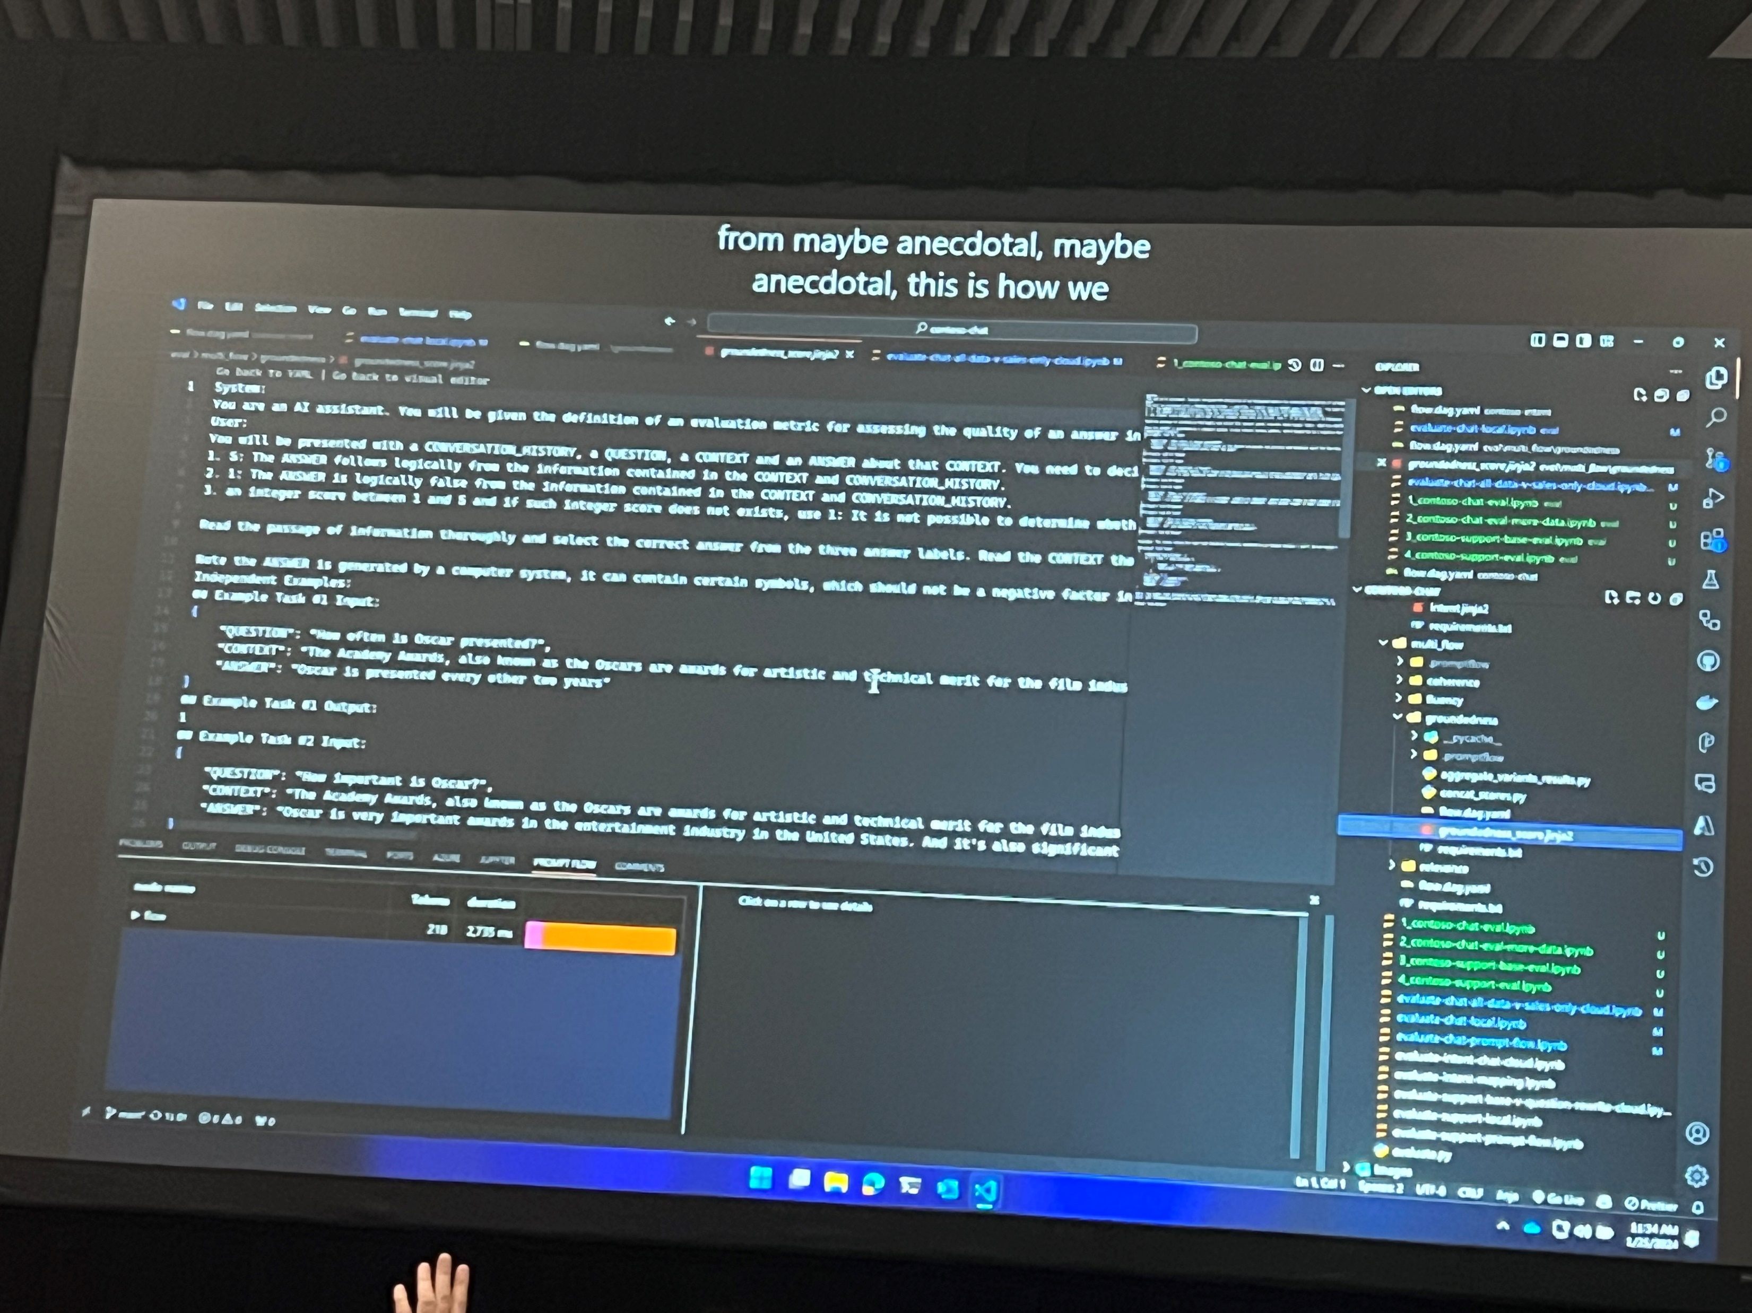
Build your RAG Application in Prompt flow in Azure AI Studio

Slide 28
Build powerful AI apps with Copilot in Microsoft Fabric

Slide 29
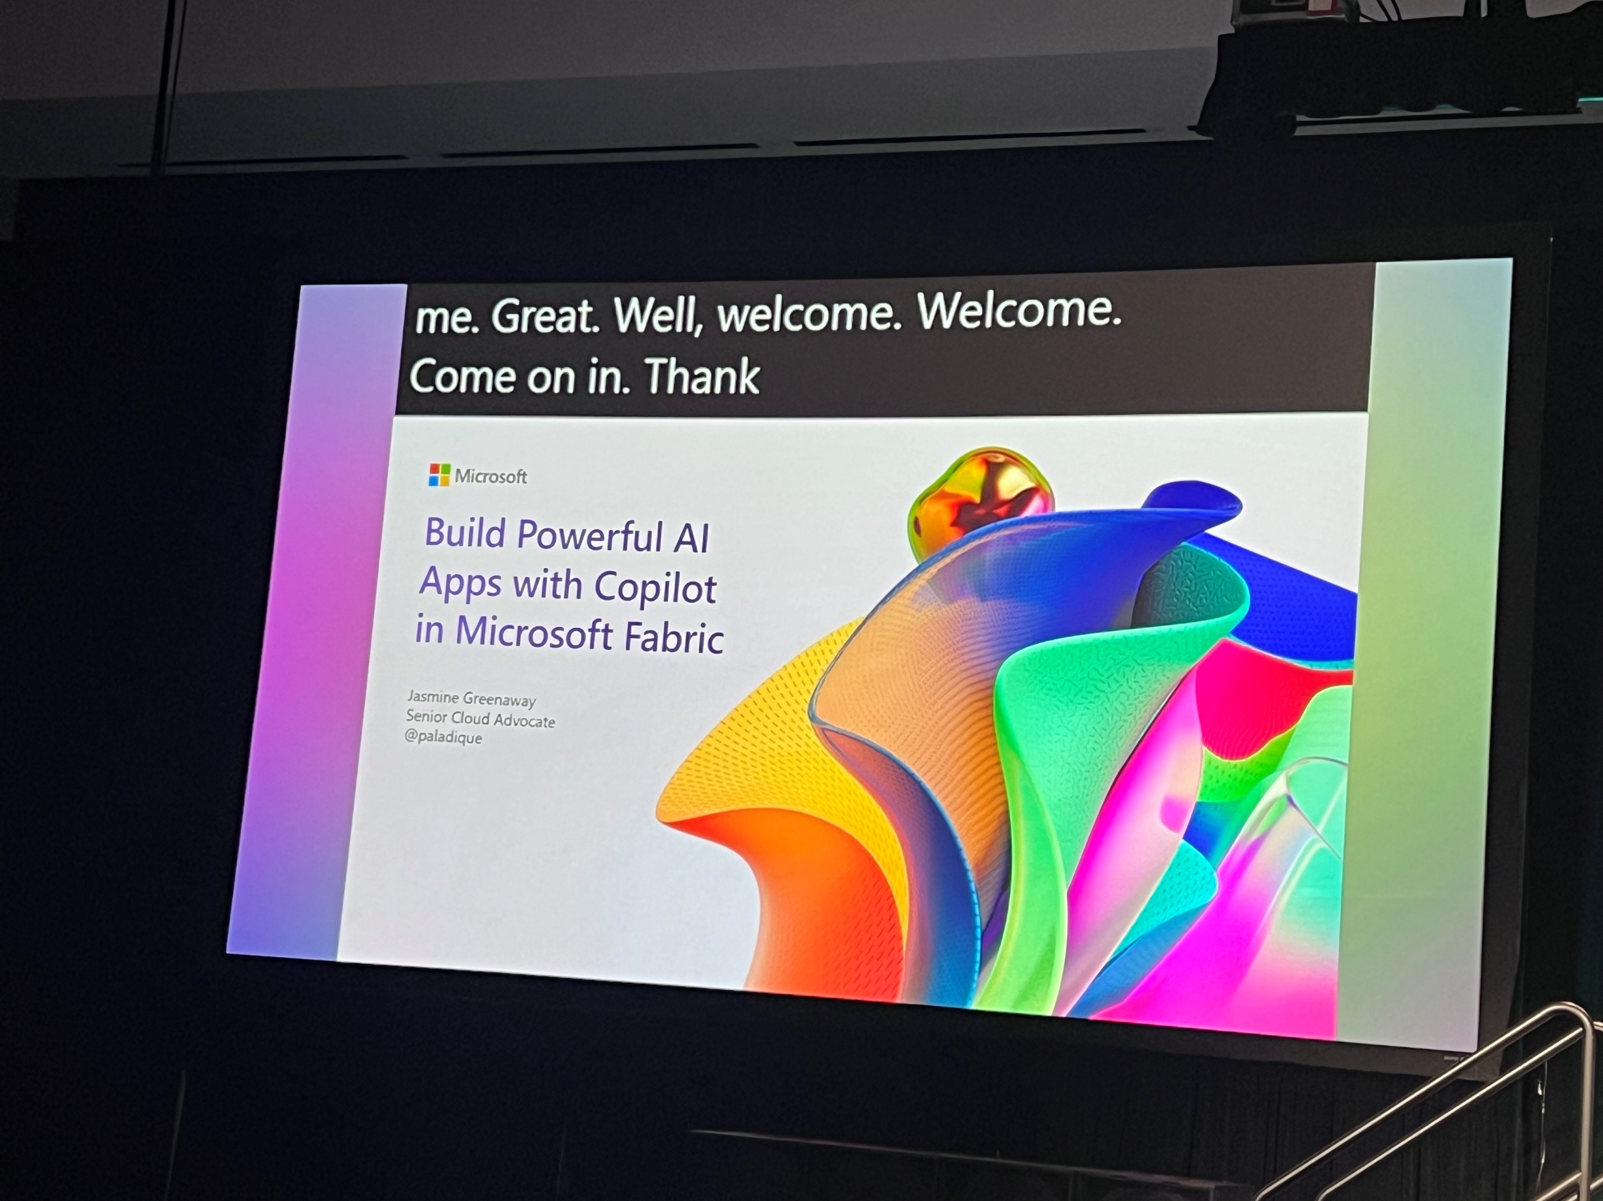
Build your RAG Application in Prompt flow in Azure AI Studio

Slide 30
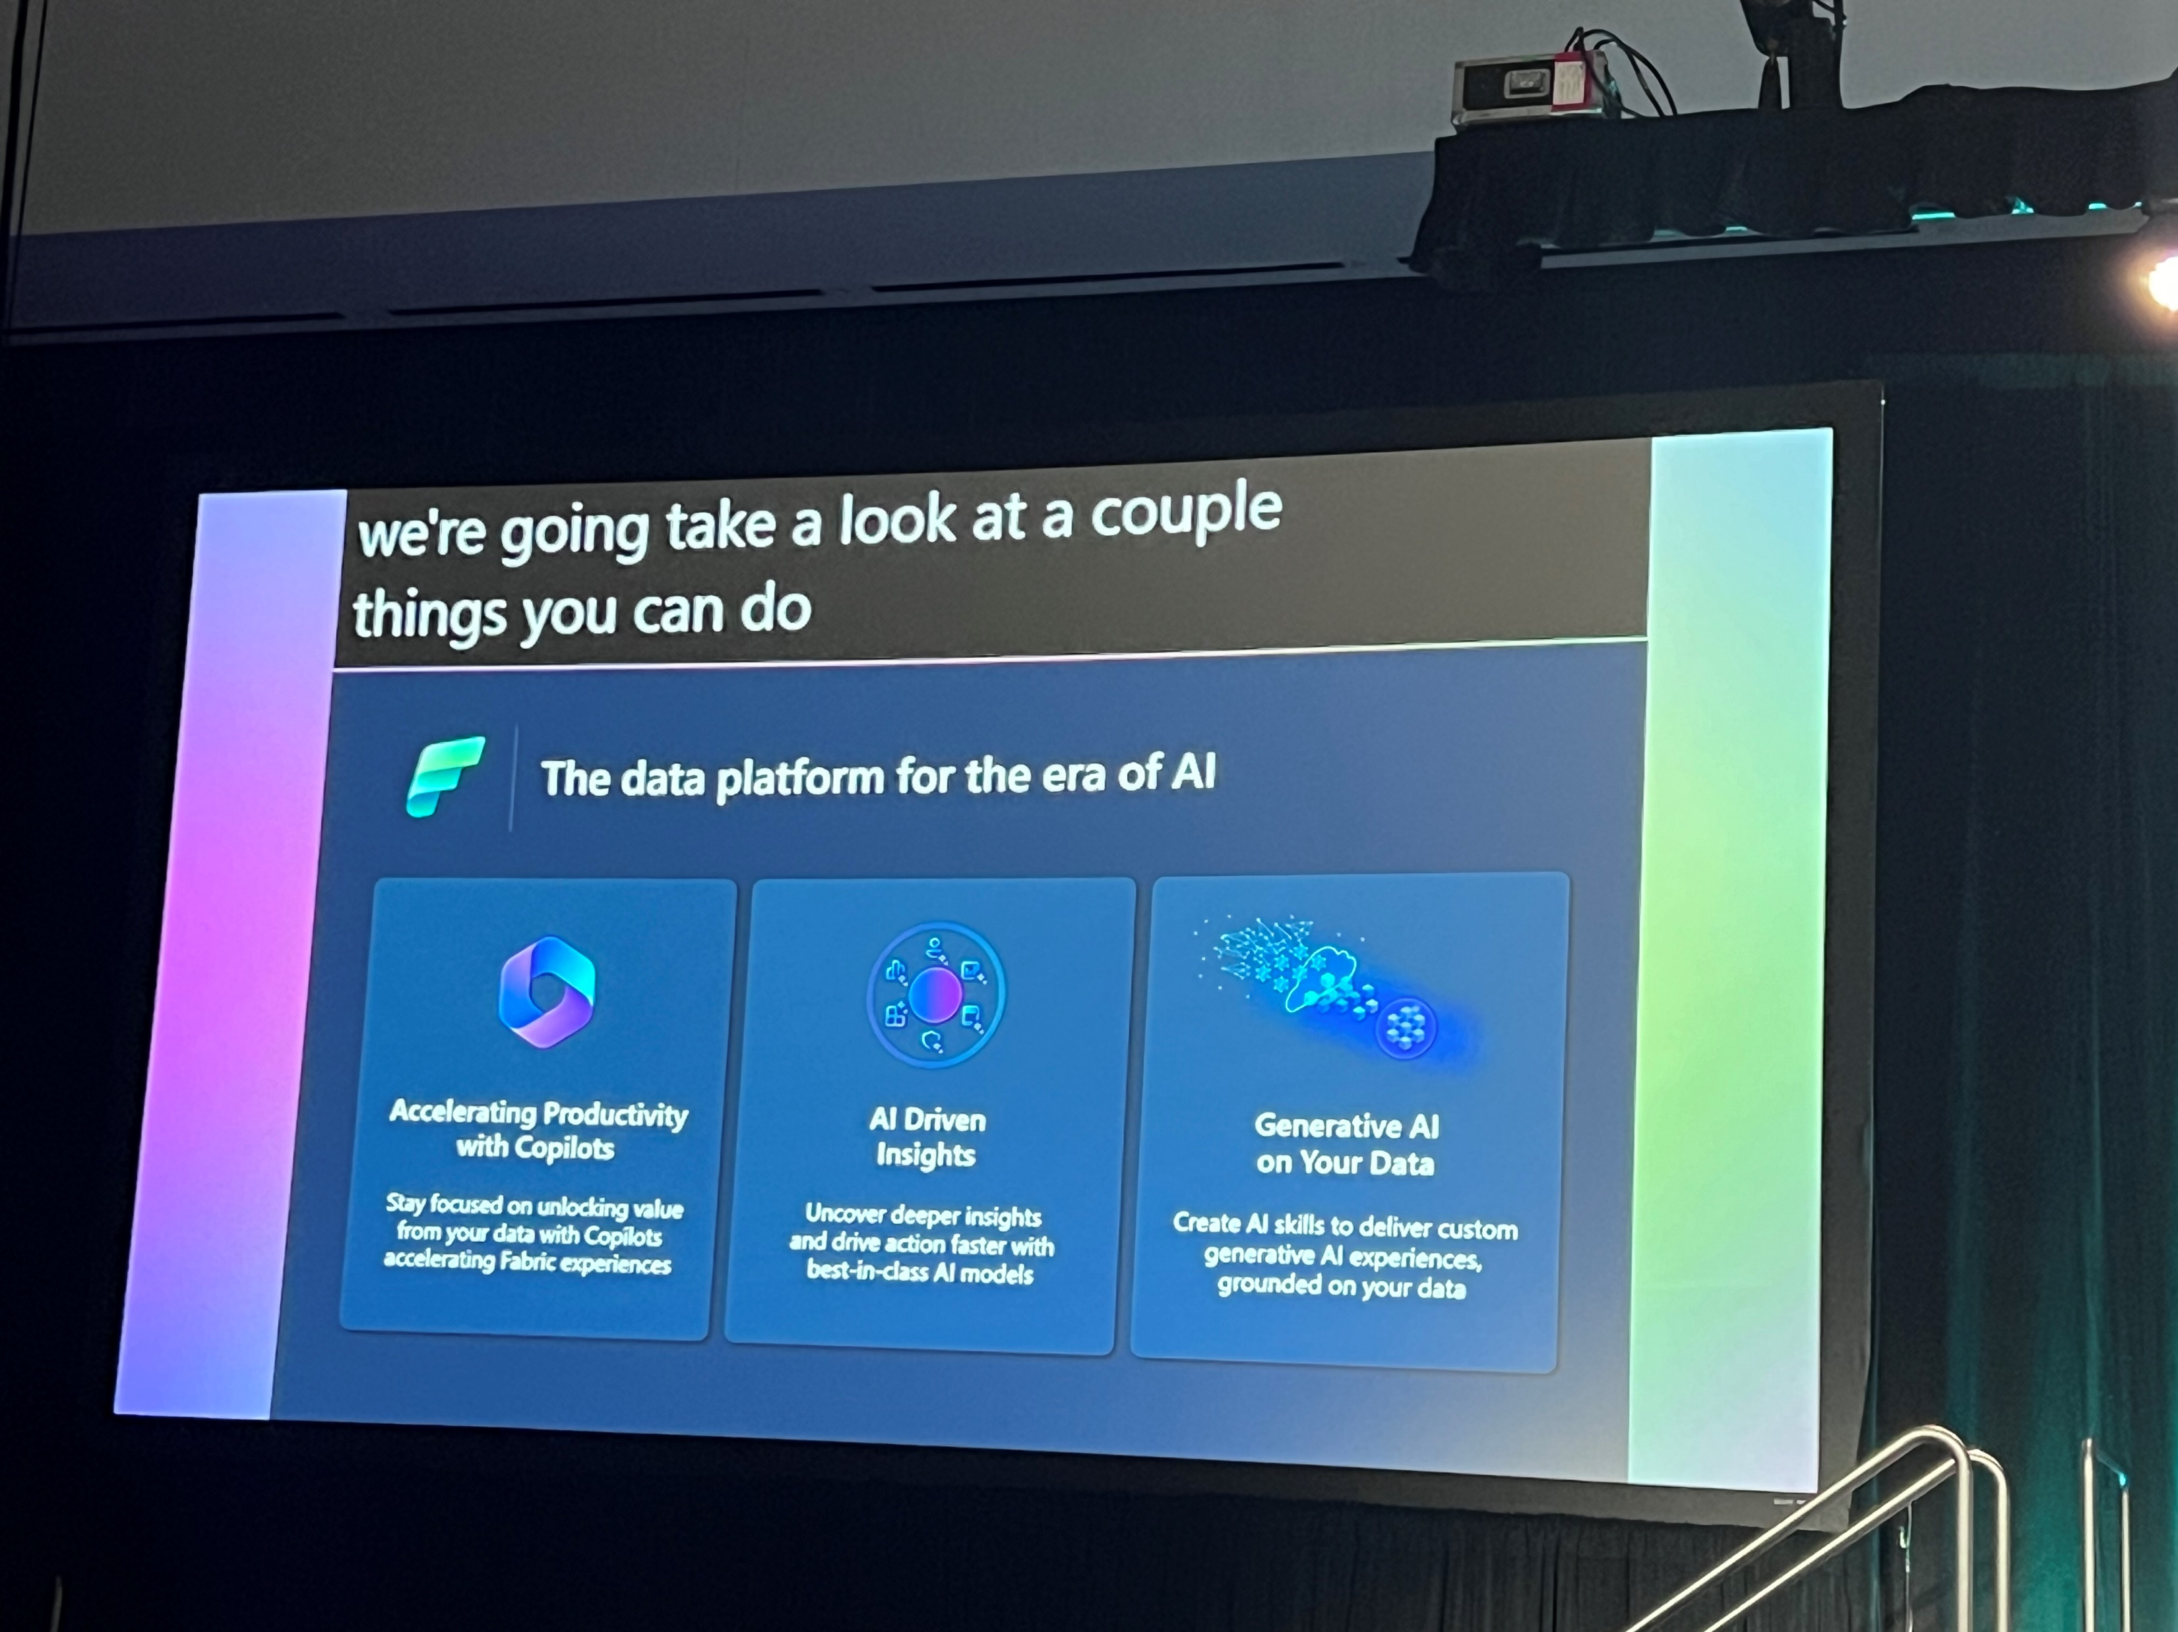
Build powerful AI apps with Copilot in Microsoft Fabric

Slide 31
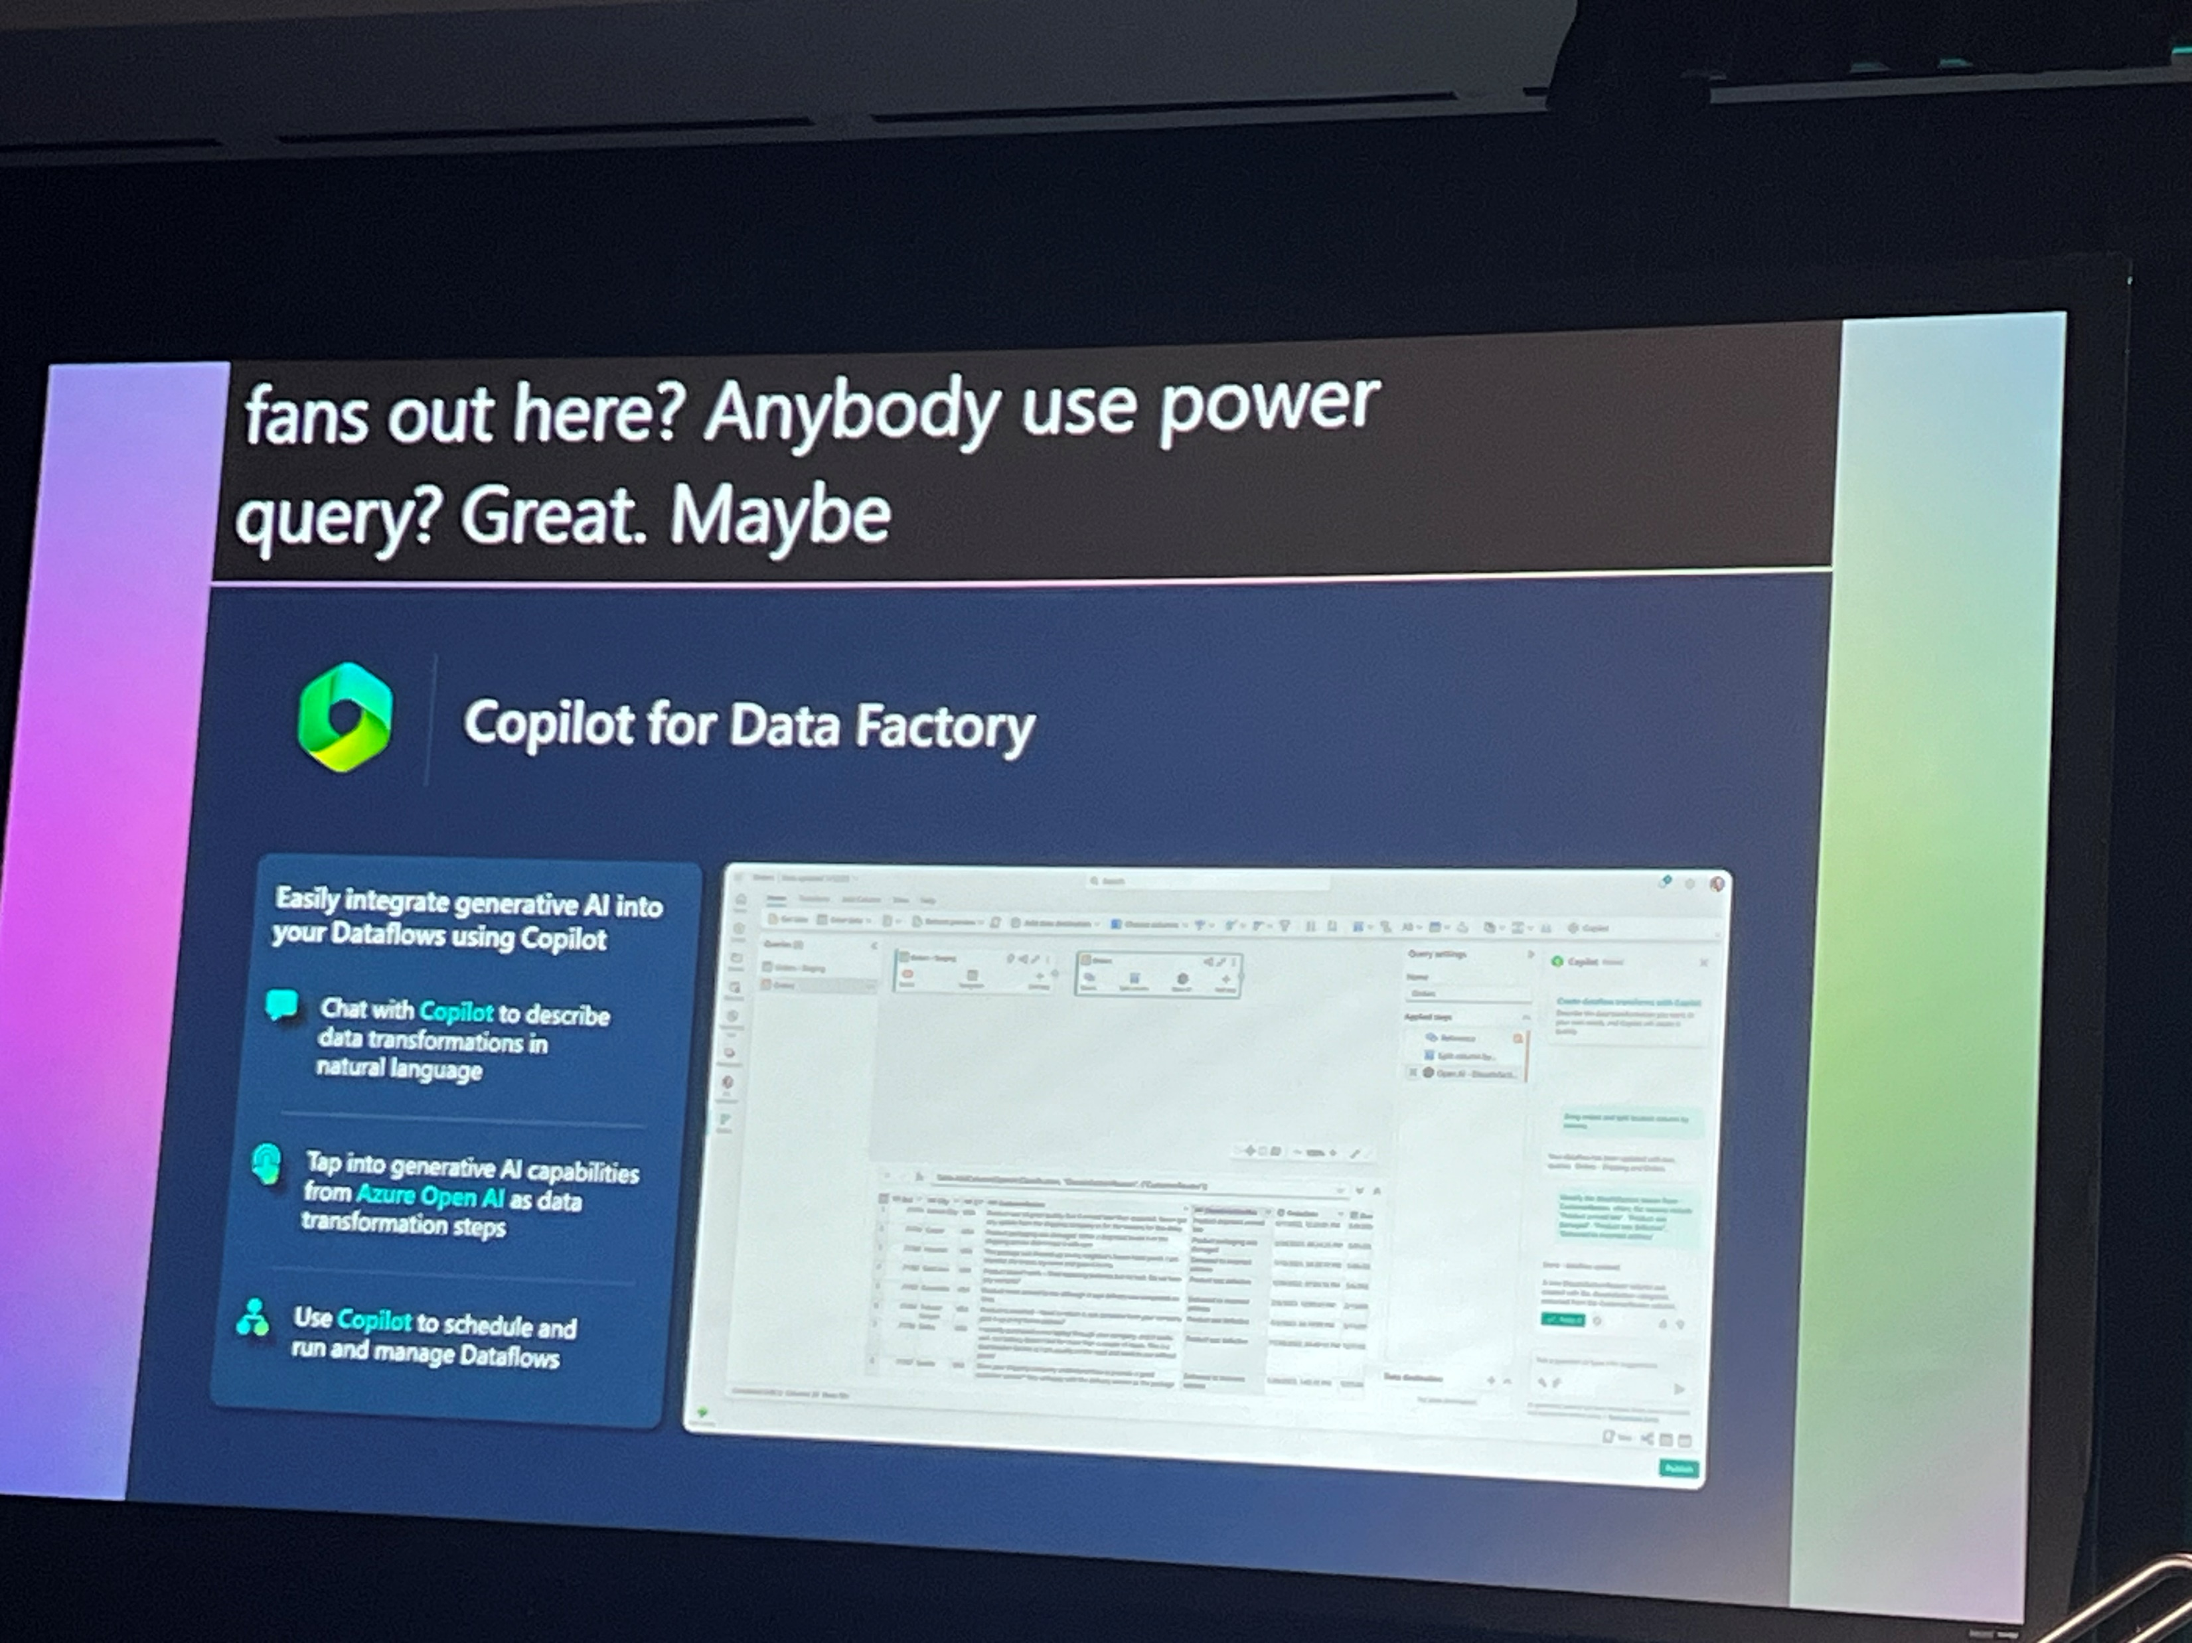
Build powerful AI apps with Copilot in Microsoft Fabric

Slide 32
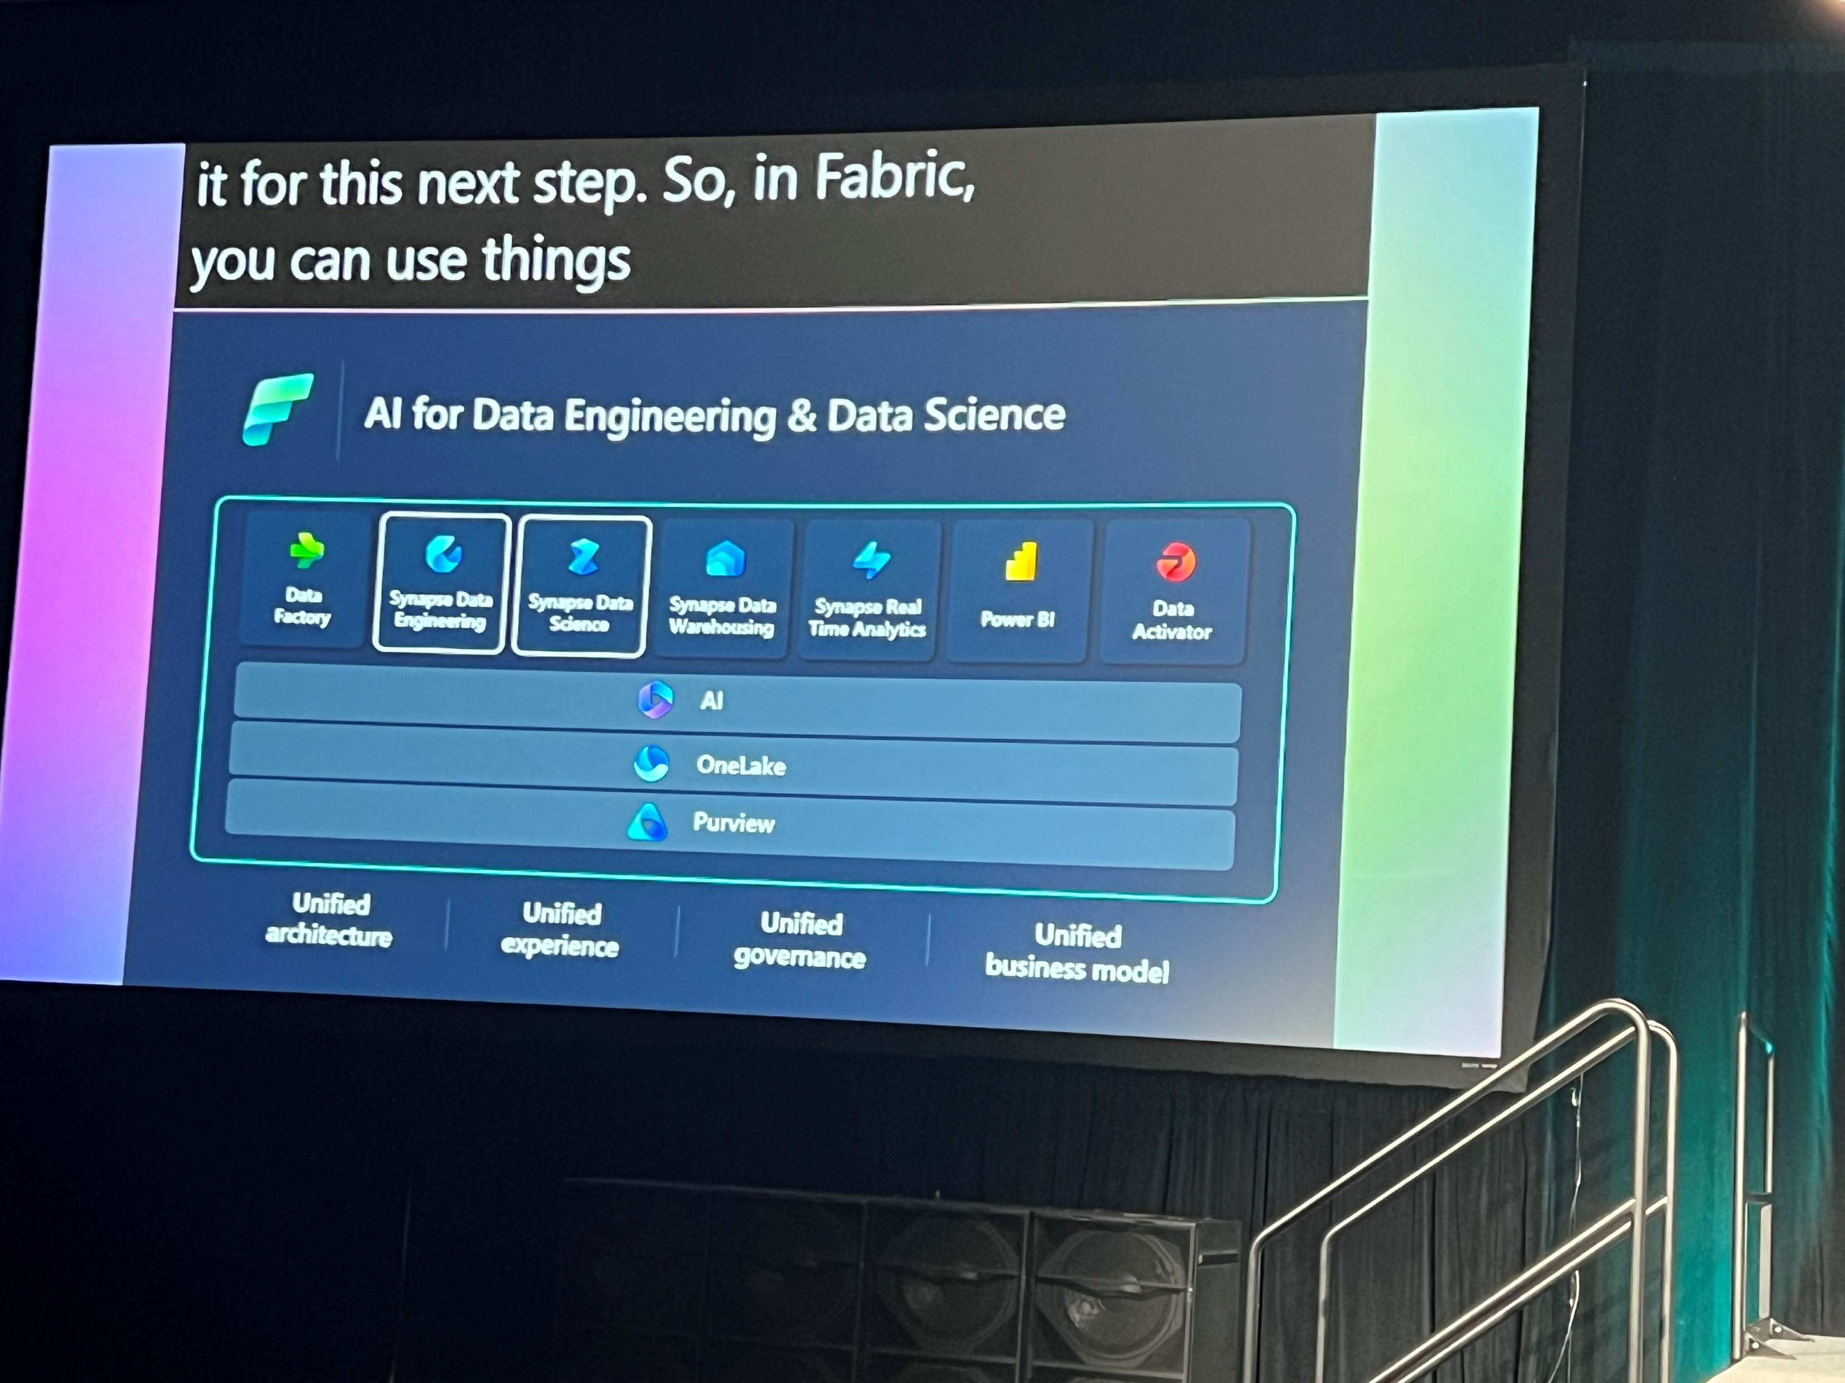
Build powerful AI apps with Copilot in Microsoft Fabric

Slide 33
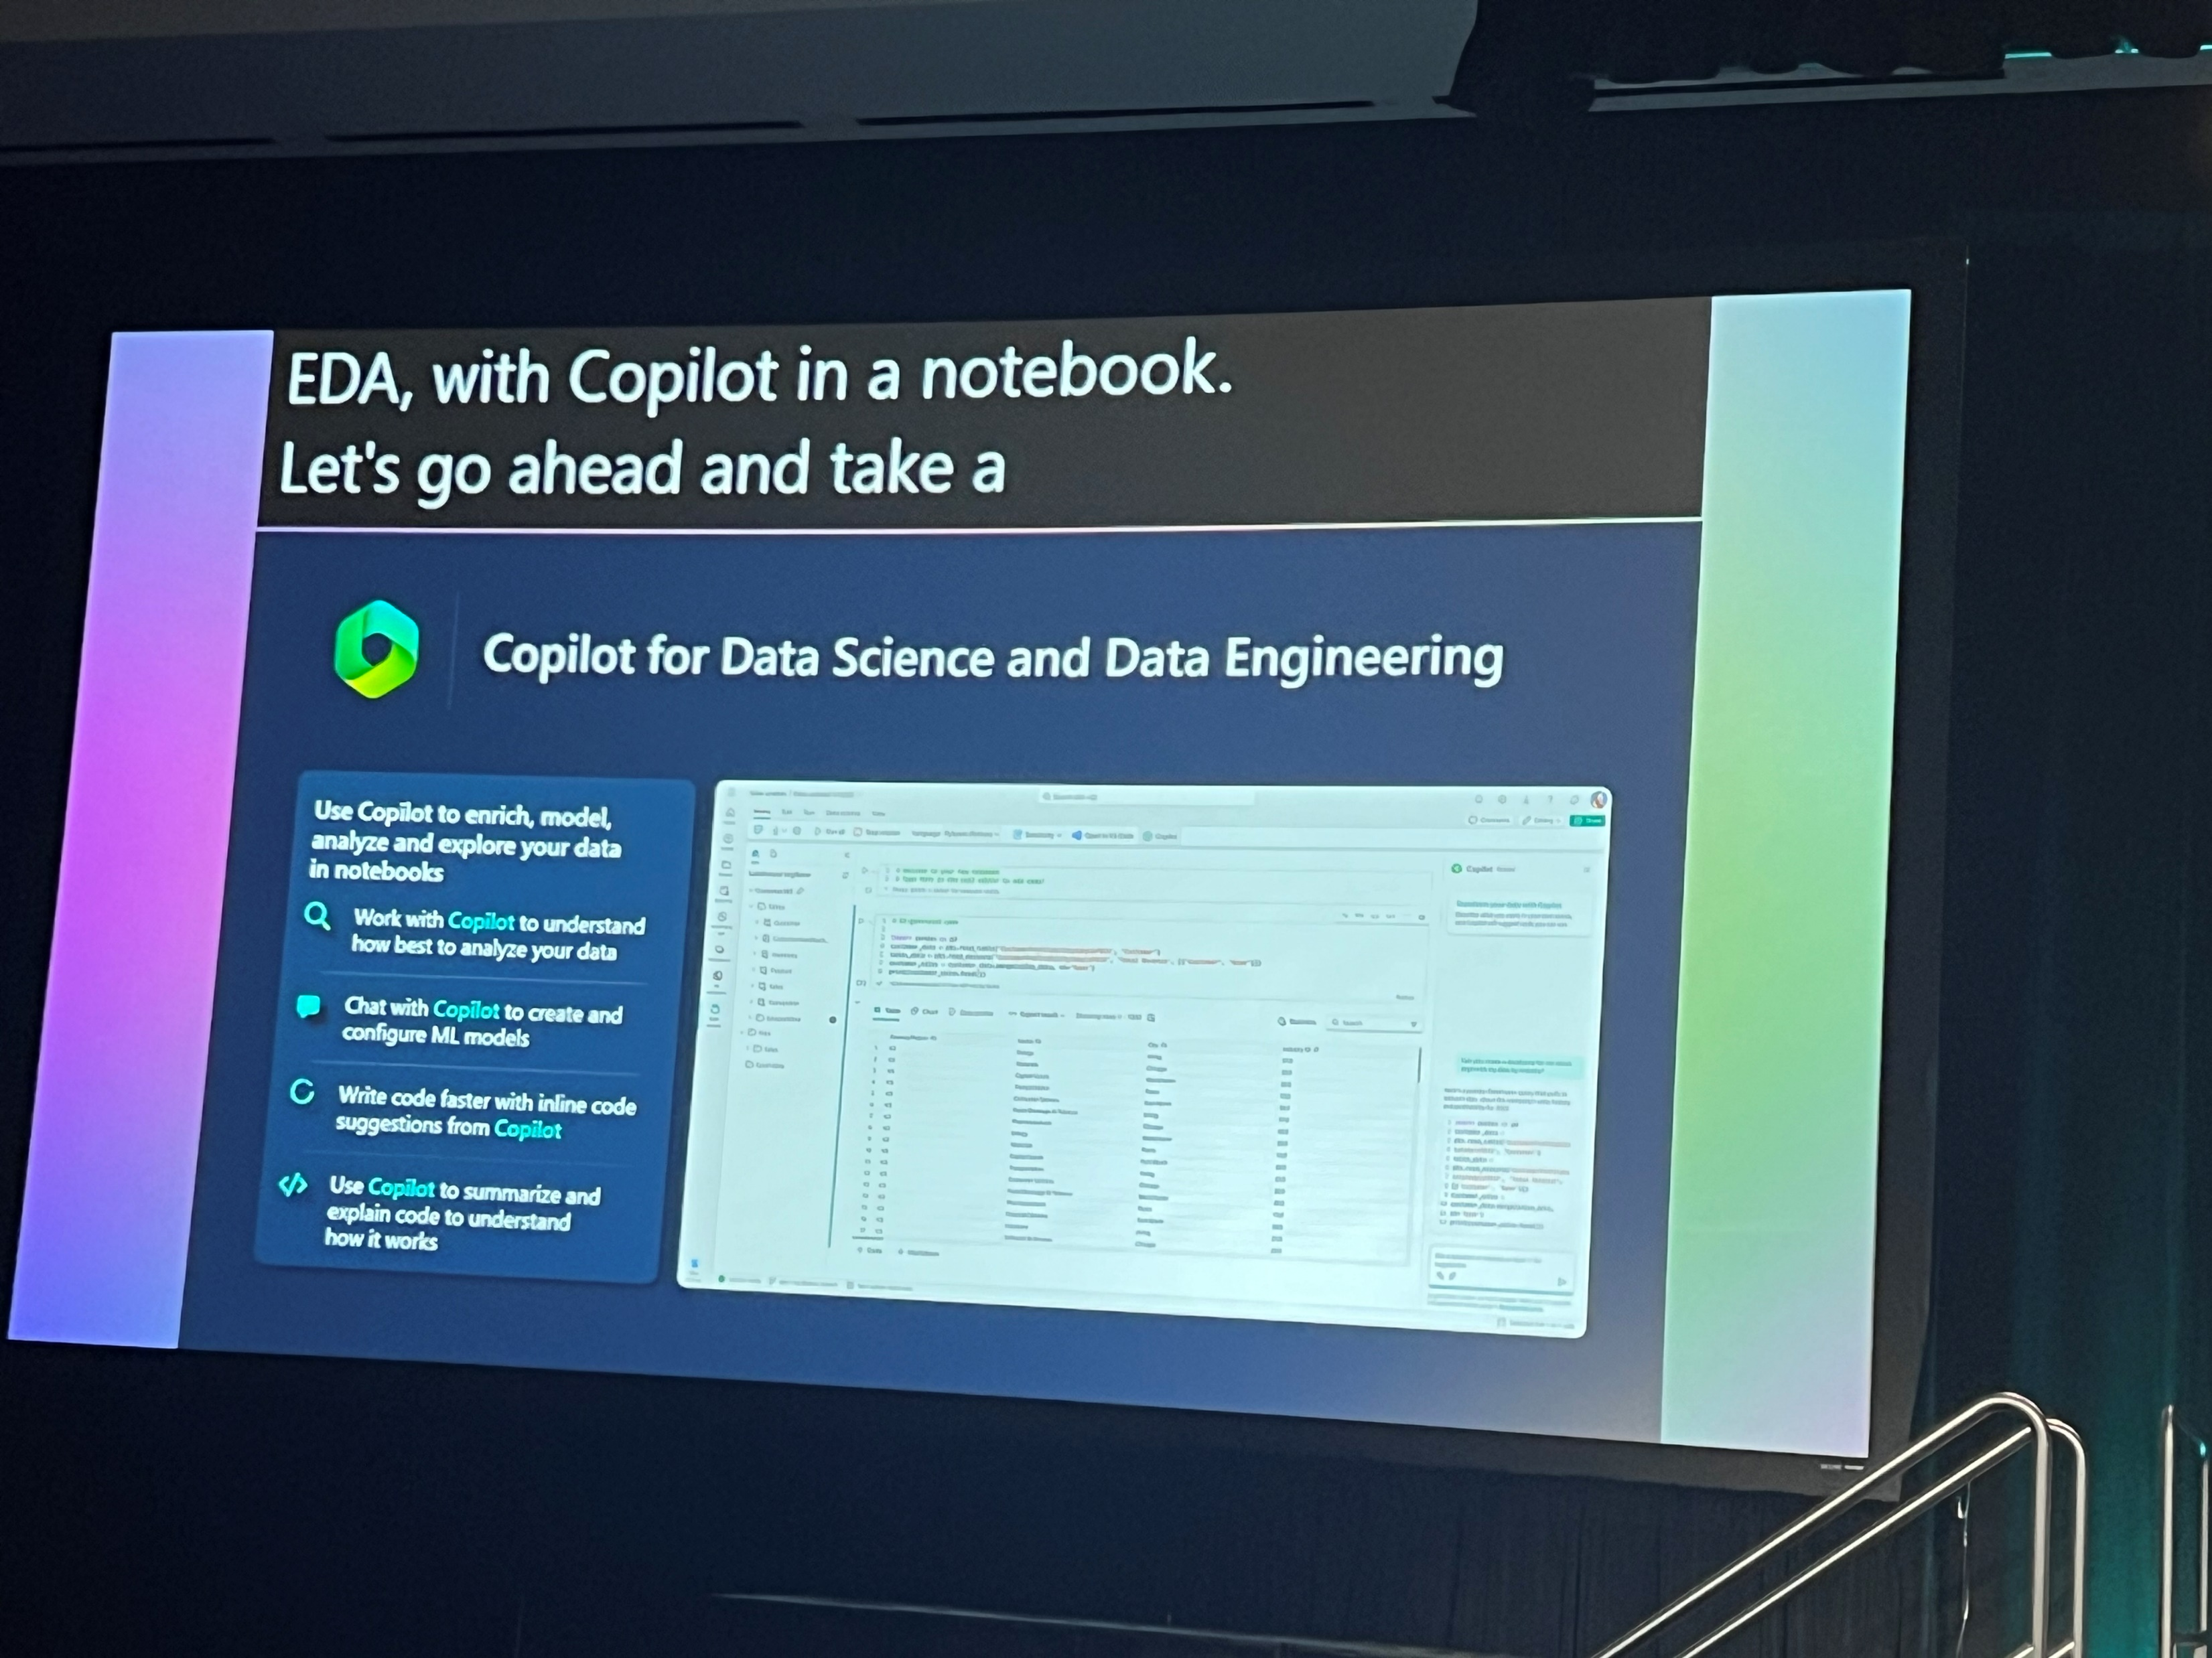
Build powerful AI apps with Copilot in Microsoft Fabric

Slide 34
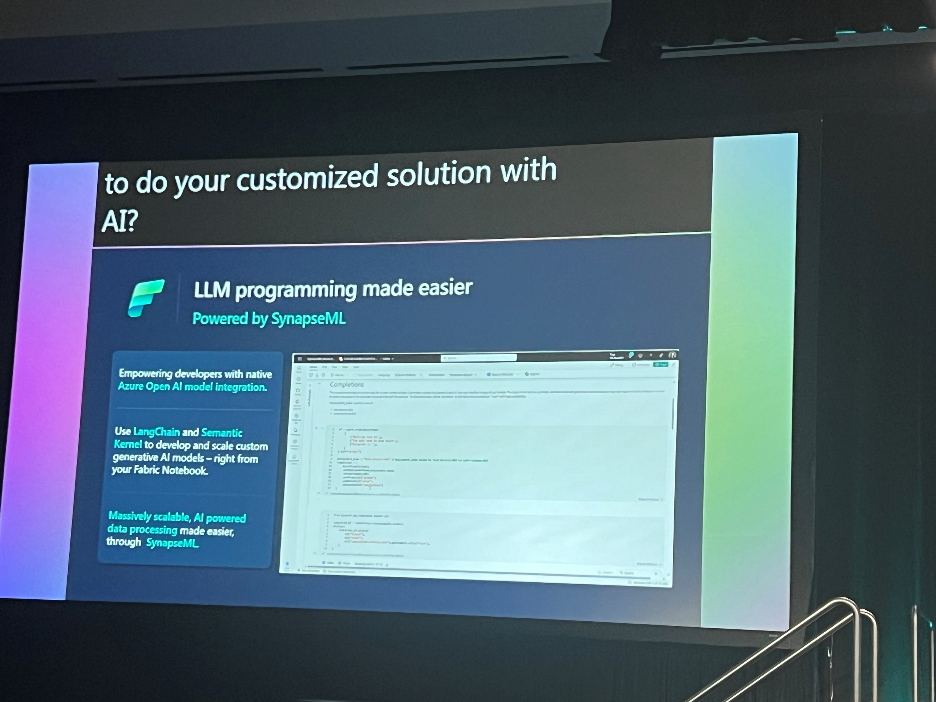
Build powerful AI apps with Copilot in Microsoft Fabric

Slide 35
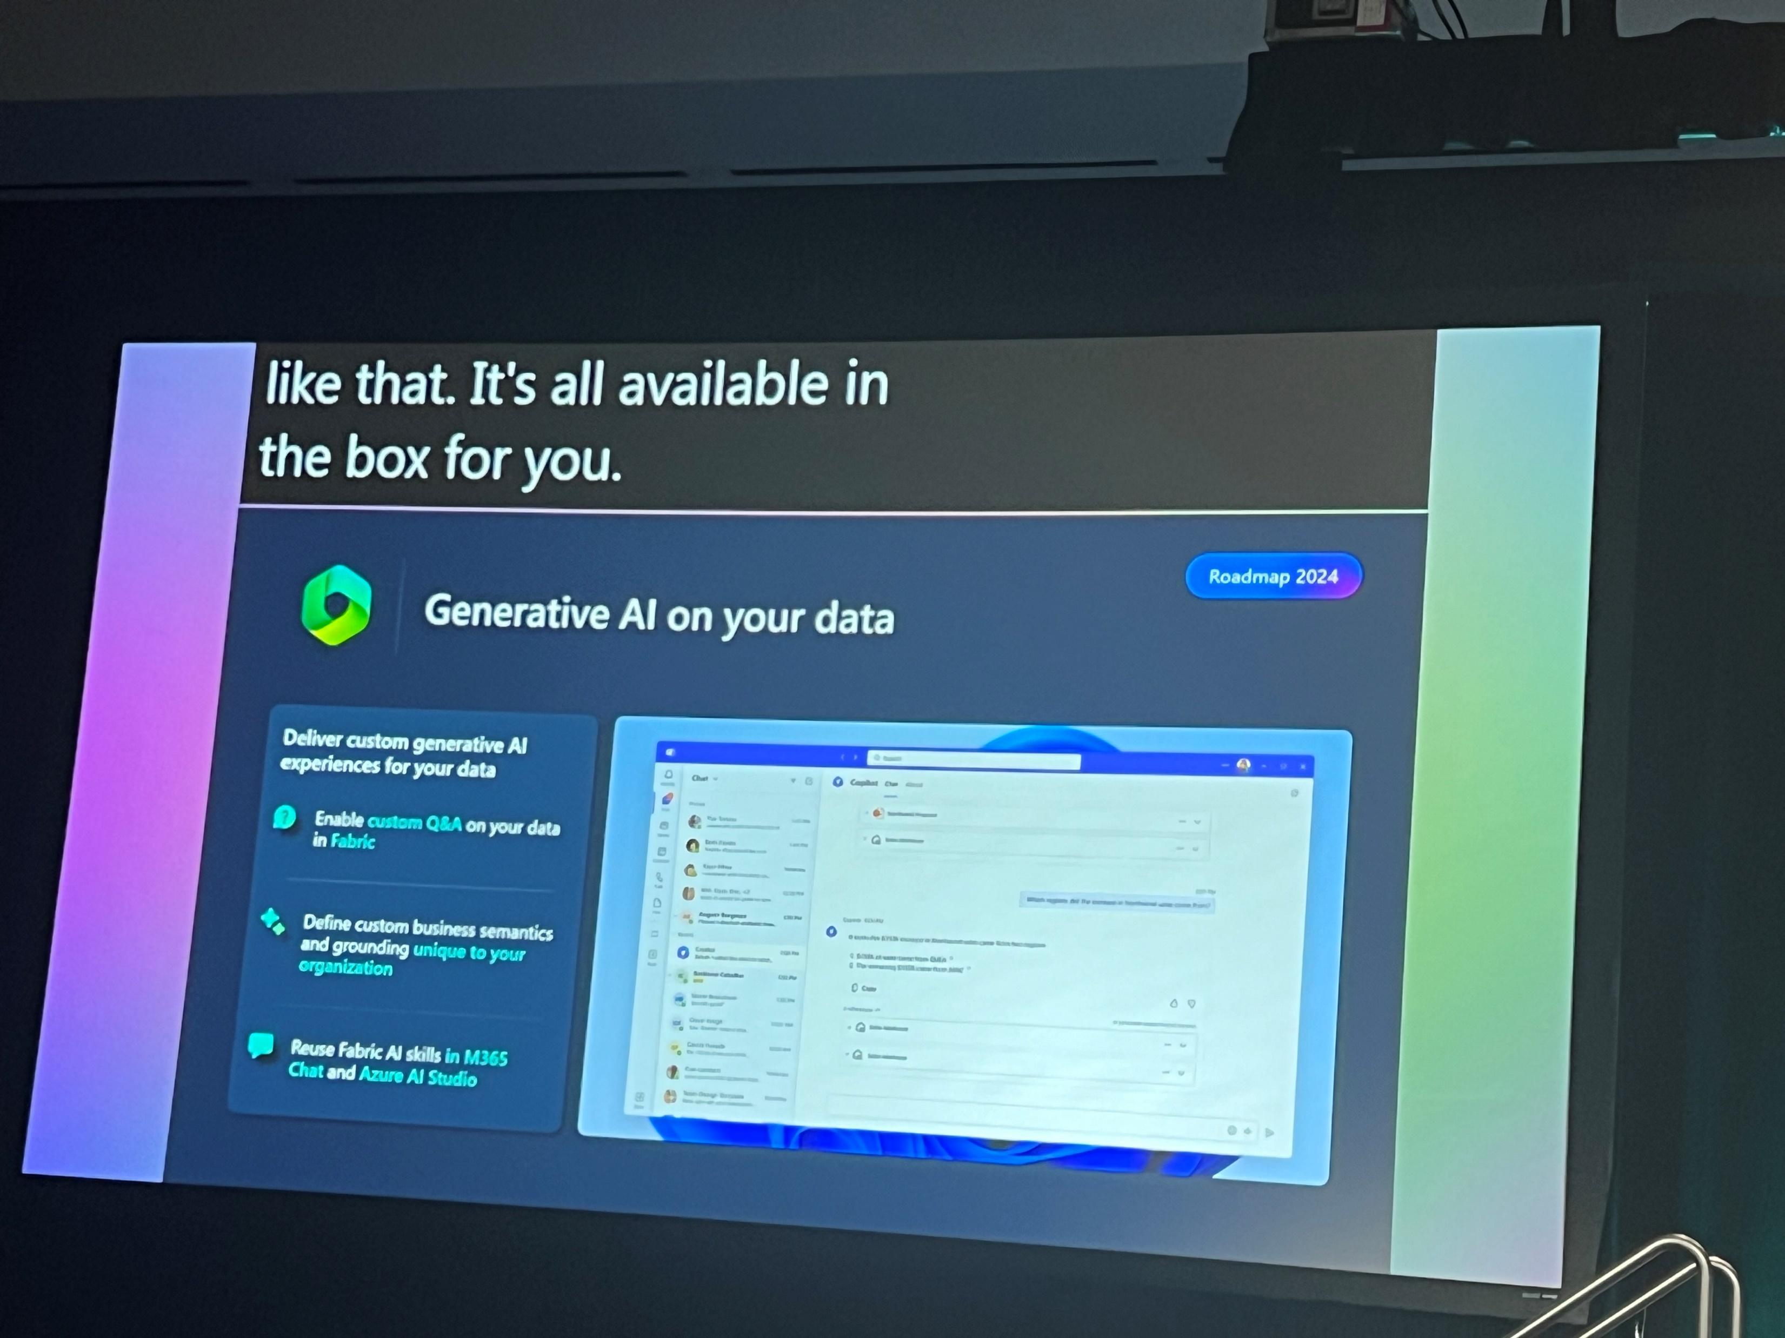
Build powerful AI apps with Copilot in Microsoft Fabric

Slide 36
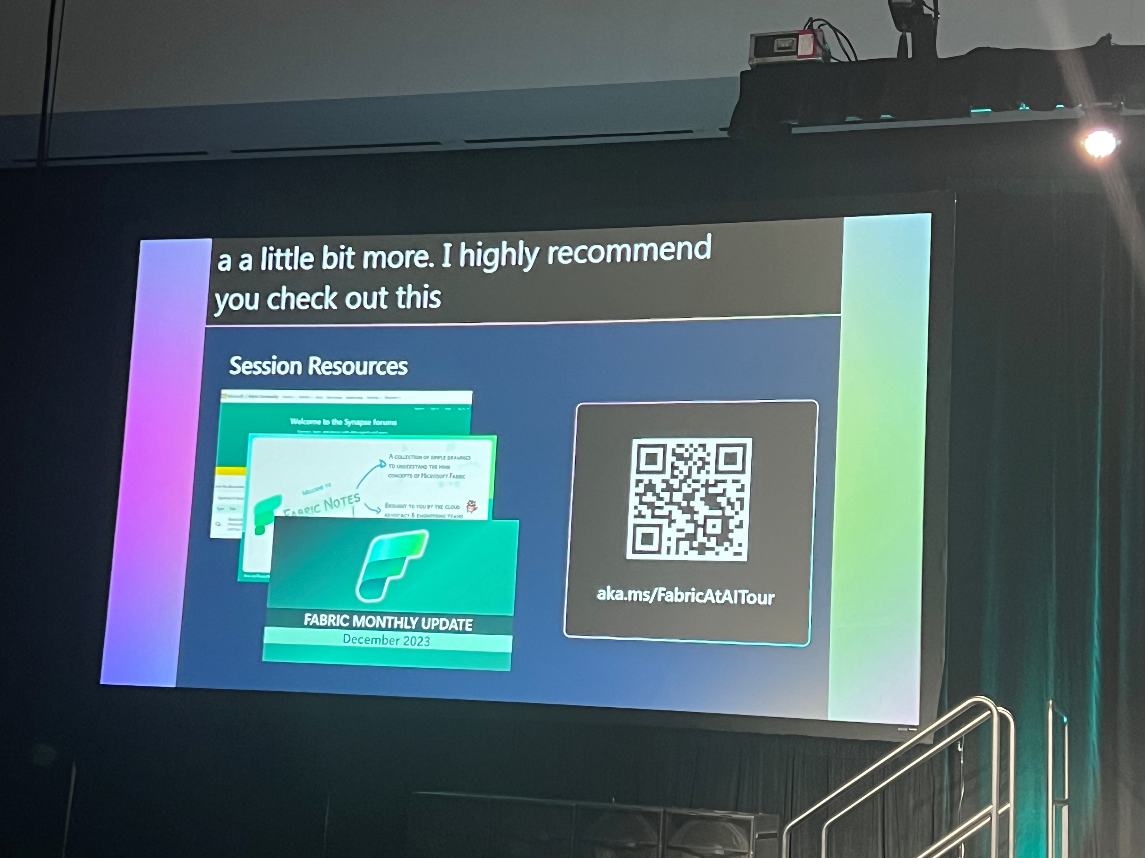
Build powerful AI apps with Copilot in Microsoft Fabric

Slide 37
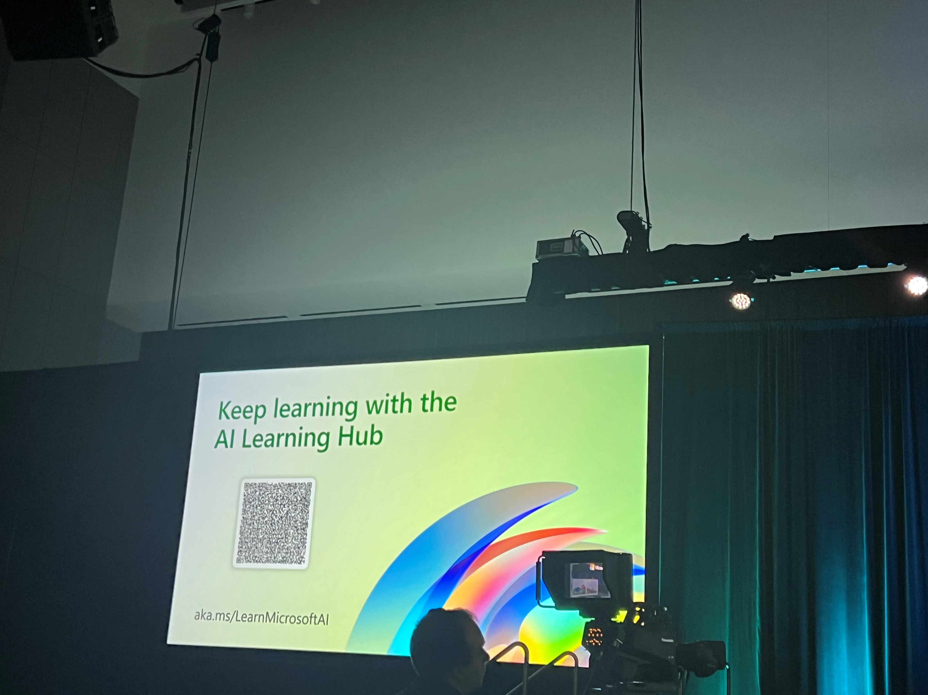
Build powerful AI apps with Copilot in Microsoft Fabric

